Slide 1
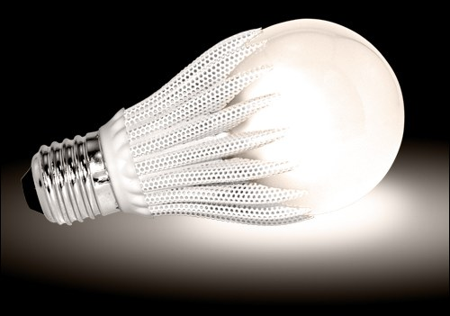

LED Lighting Solutions
Parker Han

Slide 2
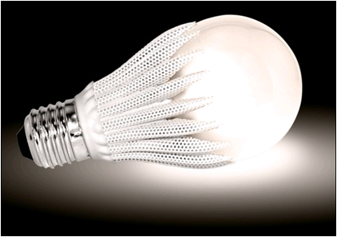
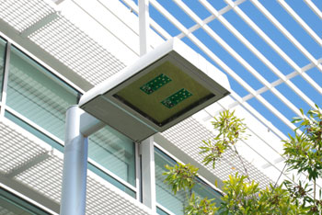
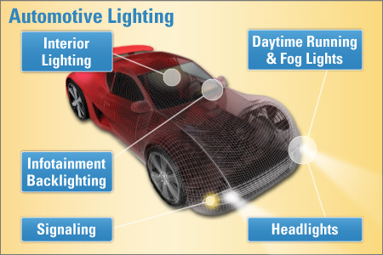
LPP is Focused on Three Primary Markets and Multiple Secondary Markets
LED Bulb
Outdoor Area
Automotive
Secondary Focus
Architectural
  Wall washer,
  Spot light, etc.
Projection
  Portable
  Desktop
2
Notes:
National has innovative, well-matched core IP
LM3445: best-in-class triac dimming
LM3464: ultra-efficient drive for large LED arrays
National can add value through vertical integration of electronics drive and control
Leverage LED drive and power supply design expertise
Apply intelligence/control capability to enable much more intelligent lighting
Markets have large volume and ROI potential
Market growth will benefit from:
Macro-economic factors such as “green” legislation
The need/drive to reduce “total cost of ownership”
2

Slide 3

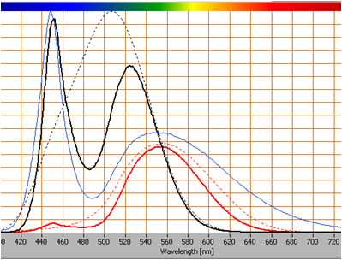
Lighting Market Evolution
Phase 1
(Now)
Phase 2
(1 – 5 Years)
Phase 3
(3 – 8 Years)
Retrofit
Raw Efficacy
Lowest Cost
Lifetime / Reliability
Sensing & Detection
Intelligence
Communications
Controls
Color / CCT Control
Spectrum Shaping
Ultra-Efficiency
>50 Year Lifetime
3
Notes:
National sees that the SSL market is still emerging and that innovation, especially with the drive and control of the LED light source, is key to driving the evolution of the lighting market
Evolution will occur in three phases:
Now: focus is on using LEDs to replace and retrofit existing lighting installations
Trying to get every lumen out of the LED system
Competing with lower cost incumbent technologies, so lowering the cost of adoption is critical to driving the proliferation of LED technology
Looking to long lifetime and reliability to both drive the total cost of ownership value proposition AND ensure that adopters are not driven away with poor quality solutions that do not meet the TCO expectations
Near Term (1-5 years): focus on developing intelligent lighting systems to fully realize system efficiency savings
Sensing/Detecting so that lights are only used when light is needed (i.e. motion sensing – no need to have light if nobody is around that needs it)
Communications for monitoring energy consumption and therefore capitalizing on energy cost savings
Long Term (3 – 8 years): focus on leveraging the controllability of LEDs
Utilizing color tuning and color temperature control to optimize lighting in a space
Continued focus on improving LEDs (more efficiency, longer life)
National sees that the electronic drive and controls will be the key to unlocking and leveraging the benefits LED light sources offer over all other light sources (LEDs alone are of no benefit if they are not used to their full potential)
3

Slide 4

Solid State Lighting Product Synergy
National Semiconductor and Texas Instruments
0-10V Dimming
Phase Cut Dimming
LED Power Supply
AC Mains
LEDs
OR
DC/DC LED Driver
CC, DHC, Dim, Fault Detection
AC/DC
PFC, TRIAC Decode
...
OR
Power Line Comms
DC/DC POL
Sensors
Temperature, Motion, Ambient Light
Wired
Comms
(PLC)
Processor MCU, ARM, DSP
Wired
Comms
Wireless
Comms
ZigBee™, 6LoWPan
Zwave, Enocean, WiFi. BT
3rd party solution
Ethernet, DALI, DMX512, etc

Slide 5
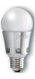
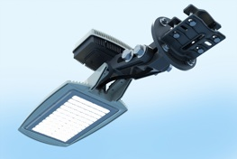
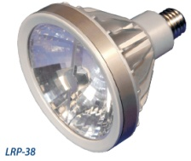

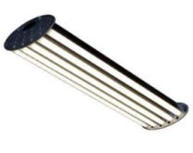





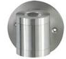
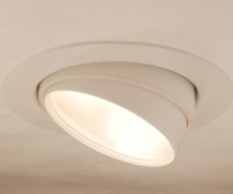
TI Lighting Power Products at a Glance
Light Bulbs & Low Power Luminaires
High Power Wide Area Luminaires
Automotive
B10, GU10, A19, PAR20-38
 | LM3445/8
 | TPS92070
 | LM3447
 | TPS92001/2
 | TPS92310/1
 | TPS92314
 | TPS92210
Street Light, High Bay, Parking, Pathway, Troffers
 | UCC28810/1
 | TPS92210
 | LM3401/9
 | LM3433/34
 | TPS92550/1
 | LM3402/4/5/5A/6/7
 | LM3414
 | LM3430/31
 | LM3410
 | LM3421/3/4/9
 | TPS40211
 | LM3432
 | LM3492
 | LM3464
 | LM3466
Exterior, Interior & Infotainment backlighting
 | LM3424Q
 | LM3421Q/23Q/29Q
 | LM3409Q
 | LM3410Q
 | LM3431Q
Hero
AC-DC
Front
End
Hero
AC-DC
Dimmable
Hero
Hero
Buck
Controllers
Hero
AC-DC
External
Dimming
Hero
New
New
Buck
Converters
Hero
Hero
MR16, AR111
 | LM3401
 | LM3444
 | LM3492
 | TPS40211
Boost
Controllers
Boost
Converters
Hero
Hero
Multi- topology
controllers
Hero
Boost + Linear
Controllers
Architectural, Wall Washers, Sconces, Downlights
 | LM3450A
 | TPS92070
 | TPS92210
Hero
Linear
Hero

Slide 6
Offline (AC/DC) LED Lighting Solutions

Slide 7
LM3447 – Introduction
Features | Benefits
Integrated phase angle decode Leading and trailing edge compatible Over 50:1 dimming range Primary side control using input voltage feed forward technique Constant input power operation with improved line regulation over wide input voltage range Fixed frequency discontinuous conduction mode operation with power factor correction Valley switching operation to achieve high efficiency and low EMI Efficient TRIAC hold current management Thermal foldback function for LED protection LED open circuit and short circuit protection | PSR, high PF, high efficiency Less peripheral components Low EMI Good line regulation
Applications
Dimmable A19, R20, PAR30/38 LED Lamps
Recessed LED Downlights and Pendent Lights
Industrial and Comercial Solid State Lighting

Slide 8
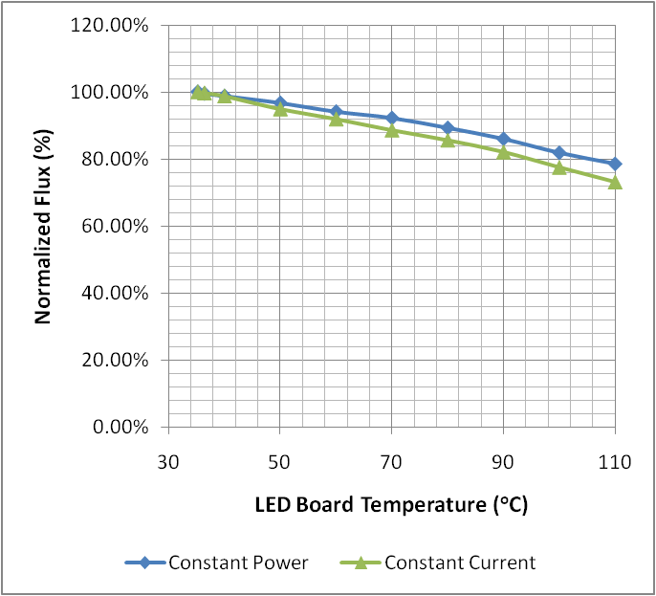
Constant Power Regulation Concept
Output power is regulated, LED current is NOT regulated
LED current varies based on forward voltage drop of LEDs
Can compensate for forward voltage variations over
  Junction temperature
  LED operating lifetime
Improvement in luminous efficacy and lamp lumen maintenance
Allows for LED heatsink size optimization
Best for LED lamps with
  Number of series LED strings
  Large series parallel LED array
Up to 5 % improvement in light output over operating temperature when using constant power over constant current

Slide 9
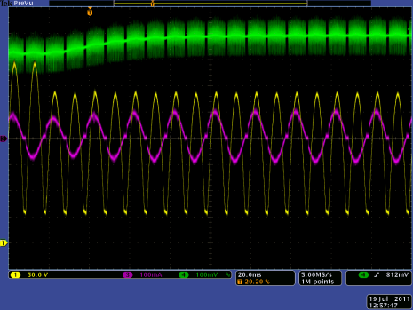
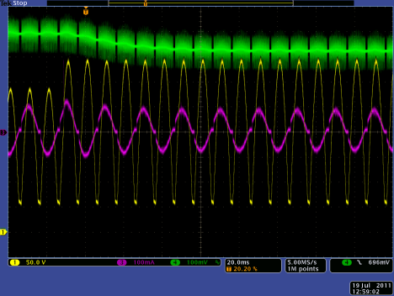
Line Regulation
Step-down transient
Line regulation < ± 3 %
Stable and damped transient response (no oscillations)
Step-up transient

Slide 10
Phase Dimming – Decoder
Dimming achieved by varying reference voltage, V_{REF}
Linear relationship between VREF and VFLT2
Decoding range
  From135° conduction angle, α_{C}
  To 45° conduction angle, α_{C}
Dimming range ~ 50:1
Low pass filter components
  R_{FLT} = 280kΩ
  C_{FLT} = 0.1μF

Slide 11
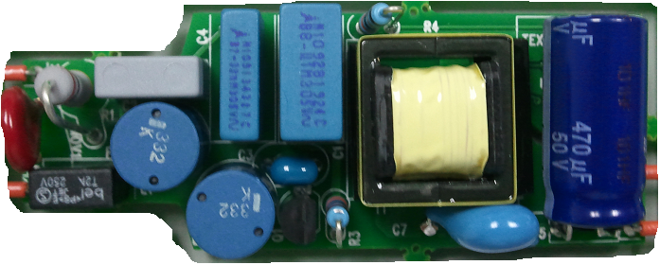
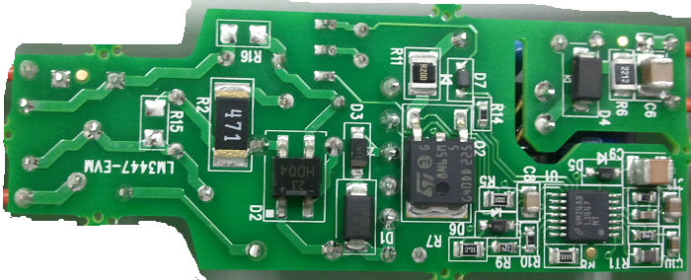
LM3447EVM Specification
LM3447 | A19-120VAC | A19-230VAC
Specification | Value | Value | Unit
Input voltage | 90-135 | 190-265 | VAC
LED config | 9-10 | 9-10 | series
Output current | 275 | 275 | mA
Output power | 7-9 | 7-9 | W
Topology | Flyback | Flyback
Efficiency | 82 | 82 | %
Power Factor | >0.95 | >0.9
Current sensing | resistive | resistive
Isolation | Yes | Yes
Notes:
Shows the specification for the driver.
9 to 11 LED’s
85% efficiency
0.99 PF
0.35A
Note LF ripple, this is due to using a single stage design for PF. The output will show ripple at twice the line frequency
Lifetime based on 8000 to 10000 hour capacitors
Fits in PAR38 blub

Slide 12
TPS92310 / TPS92311 / TPS92314
Single stage PFC AC/DC controller for LED application

Slide 13
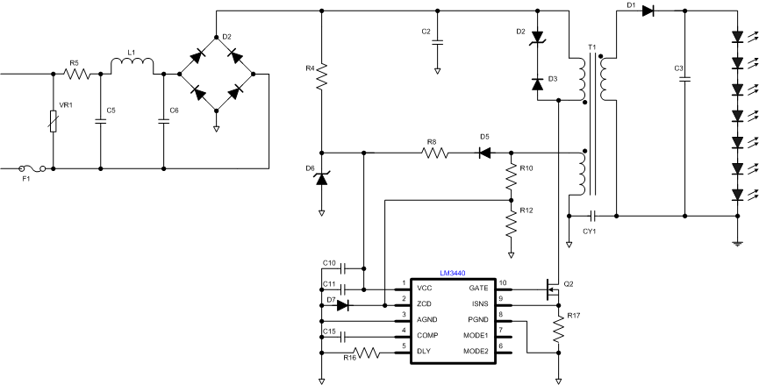

TPS92310/4
Single stage PFC AC/DC controller for LED application
Features | Benefits
Flexible Operating Modes: Constant On-Time, Peak Primary Current. | Constant On-Time implements Single Stage Power Factor Correction (PFC)
Primary side current regulation | Without opto-coupler and secondly side regulation
Without control loop compensation | Design easily
Transformer Zero Energy Detection | High Efficiency, Low EMI
Discontinuous Conduction or Transition Mode Operation | No Reverse Recovery Loss in Output Rectifier
Advanced Over-Current Protection and Integrated Over-voltage Protection | Protects Driver Against Fault Conditions
Applications
Residential LED Lighting Drivers: A19 (E26/27, E14), PAR30/38, GU10
Lighting Applications: Light Bulb Replacement, General Lighting and Solid state lighting

Slide 14
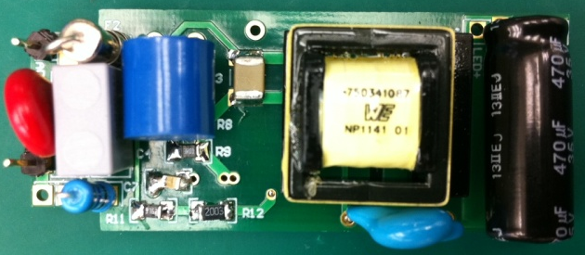
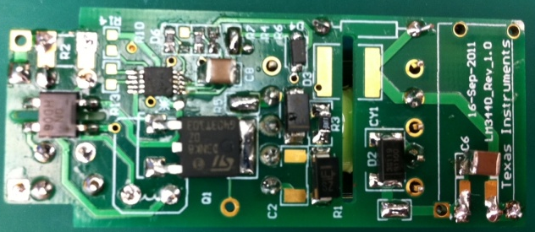
TPS92310EVM Specification
TPS92310/4 | EVM-110VAC | EVM-220VAC
Specification | Value | Value | Unit
Input voltage | 85-132 | 180-264 | VAC
LED config | 5-7 | 5-7 | series
Output current | 350 | 350 | mA
Output power | 5-7 | 5-7 | W
Topology | Flyback | Flyback
Efficiency | 85 | 85 | %
Power Factor | >0.9 | >0.9
Current sensing | resistive | resistive
Isolation | Yes | Yes
Driver Dimemsion | 55 x 23 x 18 | 55 x 23 x 18 | mm
Notes:
Shows the specification for the driver.
9 to 11 LED’s
85% efficiency
0.99 PF
0.35A
Note LF ripple, this is due to using a single stage design for PF. The output will show ripple at twice the line frequency
Lifetime based on 8000 to 10000 hour capacitors
Fits in PAR38 blub

Slide 15
TPS92311
Single stage PFC AC/DC convertor for LED application
Features | Benefits
Flexible Operating Modes: Peak Primary Current, Constant On-Time | Constant On-Time implements Single Stage Power Factor Correction (PFC)
Integrated 600V 3.6Ω MOSFET | Less component count
Transformer Zero Energy Detection | High Efficiency, Low EMI
Discontinuous Conduction or Transition Mode Operation | No Reverse Recovery Loss in Output Rectifier
Advanced Over-Current Protection and Integrated Over-voltage Protection | Protects Driver Against Fault Conditions
Applications
Residential LED Lighting Drivers: A19 (E26/27, E14), PAR30/38, GU10
Lighting Applications: Light Bulb Replacement, Solid state Lighting, industrial and commercial lighting.

Slide 16
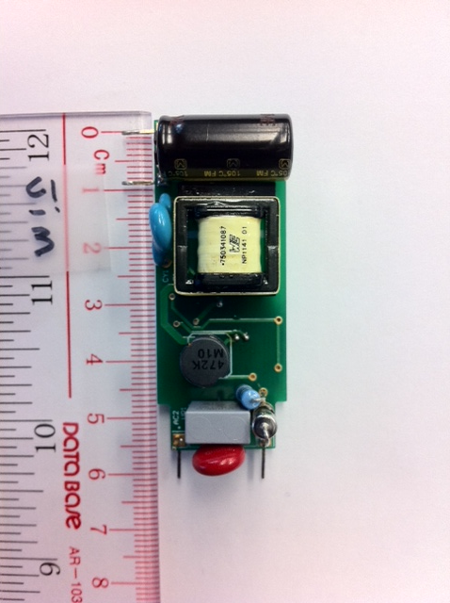
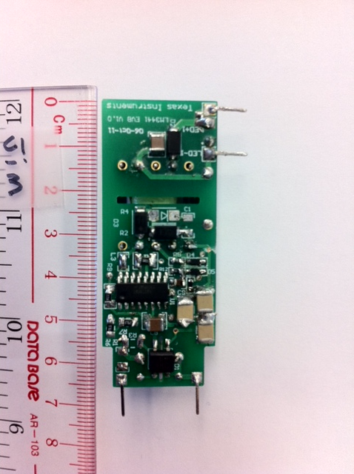
TPS92311EVM Specification
To be RTM in Mar 2012
TPS92311 | EVM-110VAC | EVM-220VAC
Specification | Value | Value | Unit
Input voltage | 85-132 | 180-264 | VAC
LED config | 5-7 | 5-7 | series
Output current | 350 | 350 | mA
Output power | 5-7 | 5-7 | W
Topology | Flyback | Flyback, CRM
Efficiency | 85 | 85 | %
Power Factor | >0.9 | >0.9
Current sensing | resistive | resistive
Isolation | Yes | Yes
Driver Dimemsion | 55 x 23 x 18 | 55 x 23 x 18 | mm
Notes:
Shows the specification for the driver.
9 to 11 LED’s
85% efficiency
0.99 PF
0.35A
Note LF ripple, this is due to using a single stage design for PF. The output will show ripple at twice the line frequency
Lifetime based on 8000 to 10000 hour capacitors
Fits in PAR38 blub

Slide 17

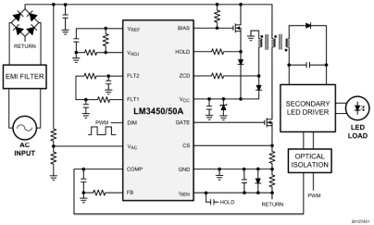
LM3450/A
LED Drivers with Active PFC and Phase Dim Decoder
Features | Benefits
Active Power Factor Correction Critical Conduction Mode with Zero Crossing Detection | Achieves Industry Lighting PFC Requirements with Low EMI
PWM Decoded from Forward and Reverse Phase Dimmer to 70:1 ratio using 500Hz PWM | High Dimming Ratio for Lighting with No Visible LED Flicker
Easily Supports Multi-String Designs | Open-Drain DIM Signal Can Be Used Across Isolation Boundary to Control Light Output Using Multiple LED Driver ICs
Integrated Dynamic Hold Circuitry | Ensures TRIAC remains in conduction for proper mapping of phase signal.
Applications
Dimmable Downlights, Troffers, and Low Bay LED Lights
Large Form Factor Bulb / Luminaire Designs
LM3450AEV-120V30/NOPB (120V)
LM3450AEV-230V30/NOPB (230V)
LM3450EV120V15W/NOPB (120V)
LM3450EV230V15W/NOPB (230V)
TOOLS

Slide 18
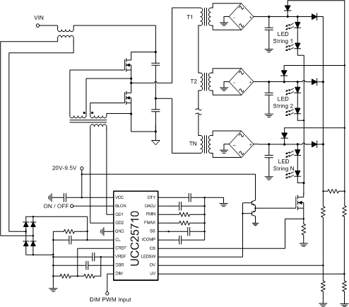
UCC25710
LLC Half-Bridge Controller for LED lighting
NEW
Features
Benefits
Single Stage approach for Multiple LED string
Driver with global dimming
50% Cost Reduction Compared to Individual
Boost Regulator Approach
LLC Resonant Half Bridge Topology
93% Plus Efficiency for Best In Class LED
Backlighting Performance
Better than 1%LED string current matching
Provides Uniform Backlighting Providing
Exceptional Picture Quality
PWM LED dimming control
Provides Simple interface to System Micro
for Intelligent Control
Programmable Dimming LLC ON/OFF Ramp
Feature
Eliminates audible noise from PWM dimming
frequency
Applications
LCD TV Backlighting
Edge Lit LCD TV
LED lighting
Street lighting
LLC Power Supplies
EVM
Available

Slide 19
Multi-Transformer Architecture for LED lighting
(TI Patented)
One transformer control two LED strings!

Slide 20
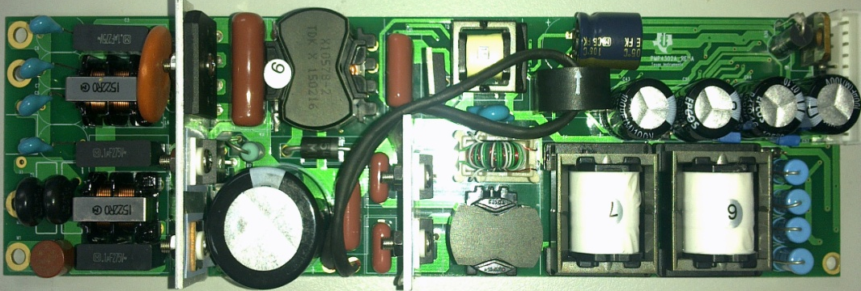
PMP4302A: Multi-string LLC AC/DC Driver for general LED lighting
Reference Design | TI Parts | V_{in} | Output | Topology | Eff. | Dimming
PMP4302A: AC input Multi-string LLC converter for general LED lighting | UCC28810 (TM PFC) UCC25710 (Multi-string LLC) UCC28610 (Aux Flyback) | 90V~264V | 54V@500mA with 4 string | TM PFC+Multi-string LLC converter | 92% | PWM dimming with CC2530 daughter board
Features
Lowest cost than AC/DC + DC/DC
Highest efficiency to 92%
PWM dimming compatible
Integrate LED open/short protection and over current protection
Applications
General LED lighting and LED backlight TV
UCC28810
UCC25710

Slide 21
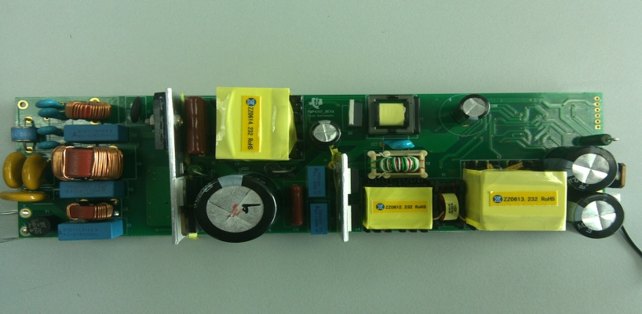
PMP4317: Single-string LLC AC/DC Driver for general LED lighting
Reference Design | TI Parts | V_{in} | Output | Topology | Eff. | Dimming
PMP4317: AC input single-string LLC converter for general LED lighting | UCC28810 (TM PFC) UCC25710 (Multi-string LLC) UCC28610 (Aux Flyback) | 90V~264V | 200V@700mA | TM PFC+single string LLC converter | 94.5% | PWM dimming with CC2530 daughter board Or 0~10V analog dimming
200V/700mA
Features
Lowest cost
Highest efficiency to 94%
PWM and analog dimming compatible
Integrate LED open/short protection and over current protection
Applications
General LED lighting and LED backlight TV
UCC28810
UCC25710

Slide 22
DC/DC LED Lighting Solutions

Slide 23
DC/DC LED Lighting Solutions
Boost |  | Buck |  | Linear
Controllers | Converters | Controllers | Converters | Controllers | Converters
TPS40211* | LM3410 | LM3401 | TPS92510 | LM3464/A | LM3466
LM3430 | TPS61165 | LM3409/HV | LM3402/HV
LM3431/A | TPS61166 | LM3421* | LM3404/HV
 | TPS61195 | LM3423* | LM3406/HV
 | TPS61500 | LM3424* | LM3405/A
 | LM3492 | LM3429* | LM3407
 |  | LM3433 | LM3414/HV
 |  | LM3434 | TPS92550/1
* Primary Topology Listed. Additional Topologies Supported.

Slide 24
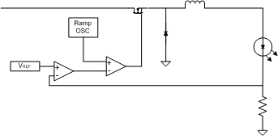
DC/DC LED Lighting Controllers vs. Converters
 | Controller | Converter
Integration | External: Switch(es) Rectifying Element Sense Resistor(s) | Internal (can include): Switch(es) Rectifying Element Sense Resistors Integrated Protection Features
Flexibility | Tunable Switching Frequency Easier to Scale for Higher Output Power Low Power Dissipation in IC Package | May be Fixed or Adjustable Switching Frequency Limited Output Power Range Limited IC Package Power Dissipation
Ease of Use | ‘Cookbook’ of Equations to Select Component Values Can be Intimidating for Novice Designer | Some Products ‘Plug and Play’ – Common Application Components Pre-Selected
Basic Buck Controller
Basic Buck Converter
Includes switching element
May include rectifying element

Slide 25
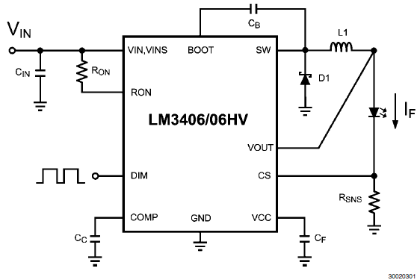
LM3406/LM3406HV
1.5A Constant Current Buck Reg. for Driving HB LEDs
Features | Benefits
VIN range from 6V to 42V (LM3406) 6V to 75V (LM3406HV) | Two Voltage Grades Optimized for Different Application Needs
Hysteretic Operation with Controlled On-Time | No Control Loop Compensation Required
Up to 1.5A Constant Current Output | Easily Drives a Variety of HB LEDs
PWM Dimming Input | Allows for External Source Such as a MCU to Control LED Brightness
Over-Temperature, LED Open/Short Protection | Protects Against Abnormal and Fault Conditions
Applications
LED General Illumination
Industrial Lighting
Automotive Lighting
LM3406MHEVAL/NOPB
TOOLS

Slide 26
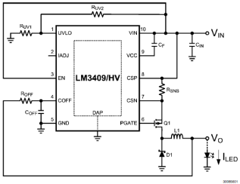
LM3409/LM3409HV
PFET Buck Controller of HB LEDs
Features | Benefits
VIN range from 6V to 42V (LM3409) 6V to 75V (LM3409HV) | Suitable for a Wide Variety of LED Applications
Can Supply 5A LED Current (1A Peak Gate Drive) | Useful in Very High Light Output Applications
Differential High-Side Current Sense (Adjustable from 0 to 248mV) | LED Cathode Can Be Ground Connected
Dimming Range PWM: 10,000:1 Analog: 250:1 | PWM – Can Use MCU for Fine Brightness Adj Analog – No LED Flicker During Dimming
Hysteretic with Controlled Off Time | Simplifies Design, Fast Transient Response
Applications
Video Projectors
Industrial Lighting, LED General Illumination
LED Flashlights
LM3409EVAL/NOPB
TOOLS

Slide 27
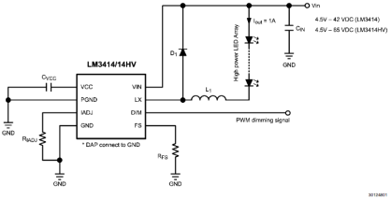
LM3414/LM3414HV
1A Floating Buck for Driving HB LEDs (No Sensing Resistor)
Features | Benefits
Input Operating Range 4.5 to 42V (LM3414) 4.5 to 65V (LM3414HV) | Two Voltage Grades Optimized for Different Application Needs
Adjustable LED current: 350-1000mA | Supports 1-3W HB LEDs
Adjustable Switching Frequency: 250kHz to 1MHz | Allows for Optimization of Efficiency Versus Inductor Size, Reduced EMI
Analog and PWM Dimming | Up to 1/10 Switching Frequency (PWM)
Internally Compensated | Simplifies Design and Reduces Component Count
UVLO, Thermal Shutdown and Open-Circuit Protection | Protects Against Abnormal and Fault Conditions
Applications
High Light Output Designs (Troffers, Architectural Lighting)
MR-16 Replacement
Automotive Lighting
LM3414HVMREVAL/NOPB
LM3414HVSDEVAL/NOPB
TOOLS

Slide 28
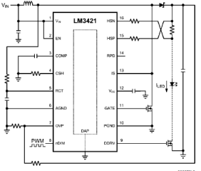
LM3421/LM3423
N-Channel Controllers for Const. Curr. LED Drivers
Features | Benefits
Input Operating Range 4.5 to 75V and Buck, Boost, Buck-Boost, and SEPIC Configurations | Suitable for a Wide Variety of LED Applications
LM3423 adds: LED Output Status Flag, Fault Flag, Fault Timer, PWM Polarity Pin | Enhanced Reporting and Control
High Side Adjustable Current Sense | Can Be Used for Analog Dimming Control
Switching Frequency Adjustable to 2MHz | Optimize for Efficiency, Size, or LED Ripple Current
Dimming: PWM and Analog | Improved PWM Dimming by Using Internal Gate Driver for External DIM FET
UVLO, Over-Voltage, and Thermal Shutdown Protection | Protects Against Faults and Abnormal Operating Conditions
Applications
Indoor and Outdoor Area Lighting
Automotive (Q100 Versions Available)
LM3421-SEPICEV/NOPB
LM3423BBLSCSEV/NOPB
LM3423BS2LYEV/NOPB
TOOLS

Slide 29
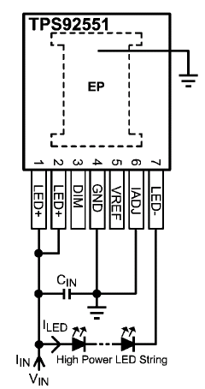
TPS92550/1
450mA 14W Constant Current Buck LED Driver Micro-Module
Features | Benefits
Integrated all power components including the power inductor | Low EMI/EMC
4.5 to 36V/60V Input Voltage Range | Easiest to be used
Constant switching frequency at 400kHz | Less components
High contrast ratio (Minimum dimming current pulse width < 16μs) | High efficiency(96%)
±3.6% typical LED current accuracy
LED current adjustable from 300mA to 450mA
Up to 96% efficiency LED open and short circuit protections
Applications
General Lighting
Architecture Lighting
Underwater Lights
TOOLS
Micro Constant current Driver

Slide 30

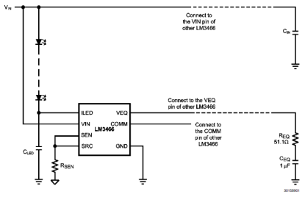
LM3466
Smart Linear LED Driver for Multi-Channel LED Systems
Features | Benefits
Wide Input Voltage Range: 6 to 70V 70V, 1.5A MOSFET with 2A Limit | Support Up to 20 LEDs in Series
Works with Constant Current Power Supplies | Regulates LED String Current Based on User Settings
Automatic Equalization | Balances Current of Every Active String, Even if String Voltages Are Not Equal
LED Open, LED Short Detection | Fault Flag Notifies MCU of Abnormal Condition
Thermal Shutdown | Protects LM3466 Against High-Temperature Conditions
Applications
LED Street Lighting, High-Bay Lighting
Multi-String LED Luminaires
tbd
TOOLS

Slide 31
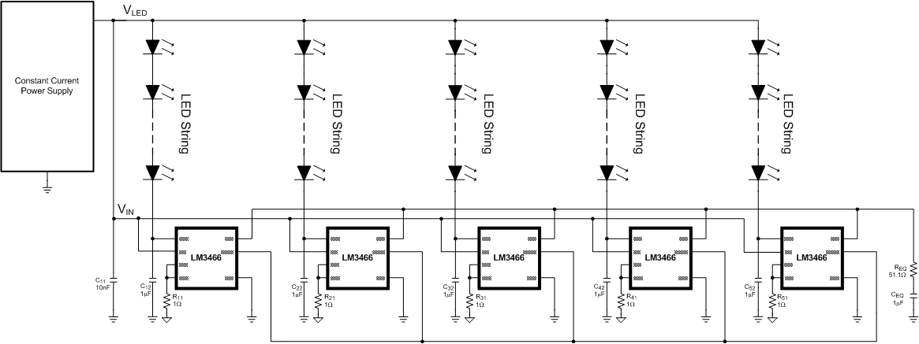
LM3466: Dynamic Current Equalizer
LM3466 is a linear LED driver which acts like an intelligent ballast resistor.
Each IC communicates with other IC’s to equalize the current in each channel i.e., divides the current equally
Application: high power fixture with multiple output channels and constant current power supply

Slide 32

  Thank You

