Slide 1

Monolithic Power Systems®
MPS Angular Sensor Introduction
Nash Zeng
2018.07

Slide 2
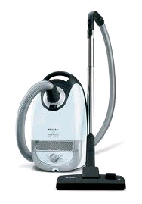
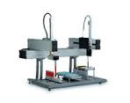
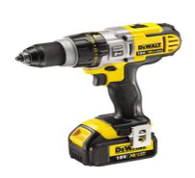
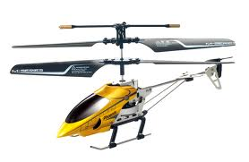
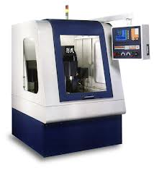

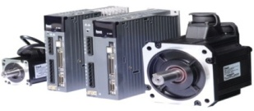
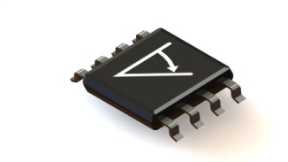
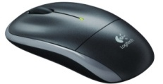
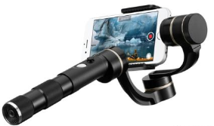
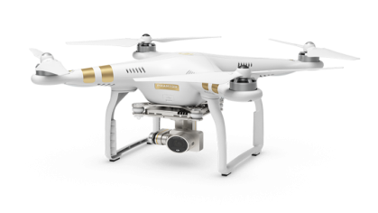
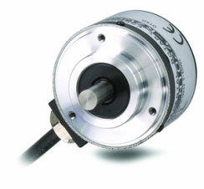
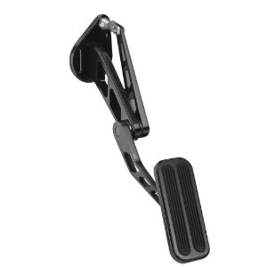
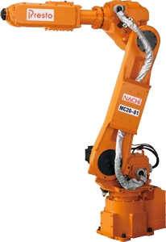
Angular Sensors Applications
Basic BLDC Motors
Speed-Controlled Drivers
Power Tools
Appliances
Industrial Automation
Hi-end Toys
Machining
Servo Motor
Knobs
Interface Devices
Gimbals
Industrial Encoders
Drones
Rotary Encoders
Automotive
Robotics
Position-Controlled Drivers

Slide 3
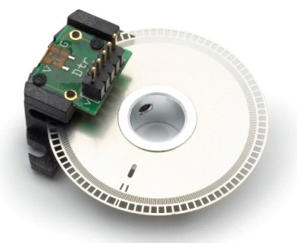
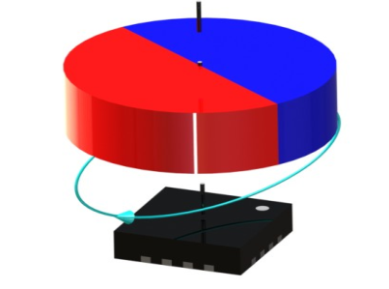
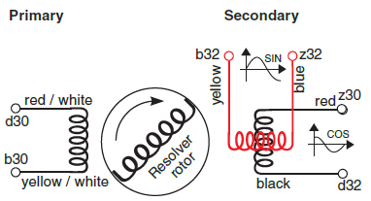
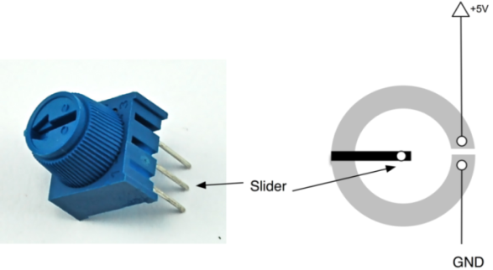
General Angular Sensors Comparison
Optical Encoder
Single Chip Magnetic
Angle Sensor
Resolver Generator
VS.
Low cost
High precision *
High speed *
Side-of-shaft ability *
Tiny system profile *
Extremely long life
Easy adjustable *
Potentiometer
* MPS Product Advantages
Notes:
Hall switches used for simple sensing when little accuracy is required. It does require very accurate mounting for magnet + sensor
Hall Switches are also used for sensing, but need a microprocessor to make calculations on speed, location, etc. along with accurate mounting.
Optical encoders are accurate, but expensive and have ruggedness/reliability issues because of dust or particles blocking light.
A silicon magnetic angle sensor is as accurate and less expensive than an optical encoder. It also gives absolute (not relative) position information, and is immune to dirt or dust.

Slide 4




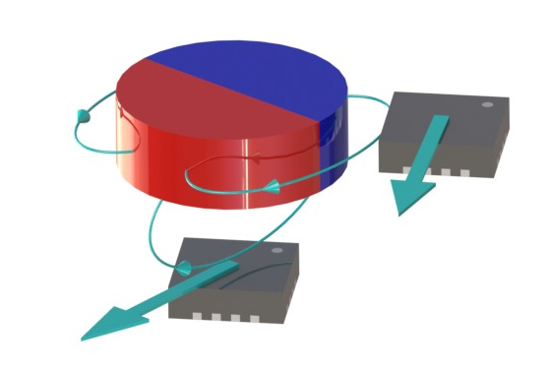



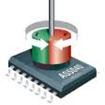
Key Advantages of MPS Angular Sensors
Monolithic Power Systems®
vs.
Most feasible mechanism
Highest sampling frequency
Shortest delay
Smallest size

Slide 5








Key Advantages of MPS Angular Sensors
Company | Product | inl | Resolution (3sigma) | Response Time | Applied Field |  | Power-Up Time | Package Size |  | Supply Current | Supply Voltage |  | Operating Temperature |  | Side-Shaft Mount | abz | uvw | Immun. Ext Field
 |  |  |  |  | Bmin | Bmax |  | larg | length |  | min | max | min | max
 |  | deg | bit | µs | mT | mT | µs | mm | mm | mA | V | V | °C | °C
 | AS5045 | 0.9 | 12 | 96 | 45 | 75 | 20000 | 7.88 | 6.2 | 16 | 3 | 5.5 | -40 | 125 | no | no | no | yes
 | AS5048 | 1.2 | 14 | 100 | 30 | 70 | 10000 | 6.4 | 5 | 15 | 3 | 5.5 | -40 | 150 | no | no | no | yes
 | AS5134 | 2 | 8.5 | 22 | 20 | 80 | 500 | 7.8 | 7.2 | 22 | 4.5 | 5.5 | -40 | 125 | no | yes | yes | yes
 | AS5055 | 1.4 | 12 | 10000 | 30 | 80 | 400 | 4 | 4 | 8.5 | 3 | 3.6 | -40 | 85 | no | no | no | yes
 | AK7405 | 1 | 12 | 20000 | 30 | 70 | 25000 | 7.5 | 7.4 | 15 | 4.5 | 5.5 | -40 | 150 | yes | 12 bits | no | no
 | AEAT-6600 | 0.4 | 12 | 442 | 90 | 120 | 10000 | 6.4 | 5 | 17 | 3 | 5.5 | -40 | 125 | no | yes | yes | no
 | IC-MH | 0.5 | 12 | 50 | 25 | 125 | 300 | 5 | 5 | 8 | 4.5 | 5.5 | -40 | 125 | no | 12 bits | yes | yes
 | IC-MH8 | 0.35 | 12 | 50 | 25 | 125 | 300 | 5 | 5 | 8 | 4.5 | 5.5 | -40 | 125 | no | 12 bits | yes | yes
 | TLE5012 (fast mode) | 1 | 9 | 21 | 30 | 50 | 500 | 5.8 | 4.8 | 14 | 3 | 5.5 | -40 | 150 | no | yes | yes | no
 | MLX90316 (fast mode) | 1 | 12 | 200 | 20 | 70 | 15000 | 5.8 | 4.8 | 16 | 4.5 | 5.5 | -40 | 150 | yes | no | no | no
 | HAL3625 | 0.7 | 9 | 1000 | 20 | 100 | 7000 | 5.8 | 4.8 | 10 | 4.5 | 5.5 | -40 | 170 | yes | no | no | no
 | AM4096 | 0.2 | 12 | 30.7 | 50 | 50 | 1500 | 10 | 8 | 26 | 3 | 5.5 | -40 | 125 | no | yes | yes | yes
 | AM8192 | 0.2 | 13 | 220 | 40 | 40 | 10000 | 12 | 12 | 39 | 4.75 | 5.25 | -40 | 125 | no | yes | no | yes
 | A1332 | 2 | 10.1 | 68 | 30 | 100 | 40000 | 6.4 | 5 | 20 | 4.5 | 5.5 | -40 | 125 | yes | no | no | no
 | A1334 | 1.75 | 9.2 | 60 | 30 | 100 | 300 | 6.4 | 5 | 10 | 4.5 | 14.5 | -40 | 150 | no | no | no | no
 | MA 300 | 1.5 | 12 | 3 | 20 | 150 | 25 | 3 | 3 | 7 | 3 | 3.6 | -40 | 125 | yes | 10 bits | yes | no
MagAlpha Key Advantages
Side-Shaft Mounting Possible
High Sampling Frequency Up to 1MHz
Ultra-Short Latency 3~10µs
Small Package QFN3mmx3mm
Low Power Consumption 7~12mA

Slide 6
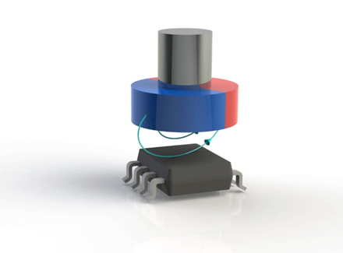
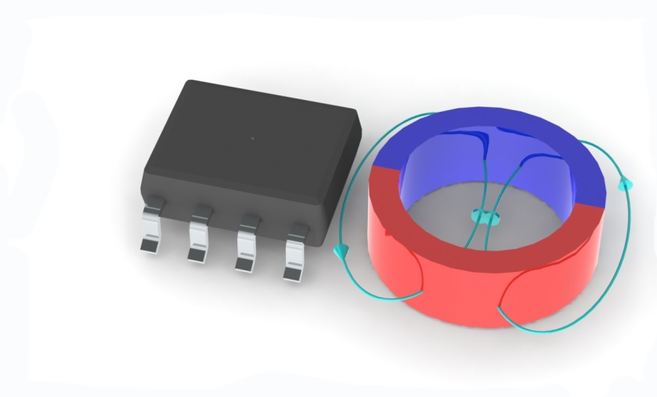
MPS Magnetic Angular Sensors
Feasible mechanism with the same device!~
Cylinder magnet or ring magnet
1 pole-pair magnet or Multi-pp magnet
On-axis or off-axis mounting
End-of-shaft
Side-shaft

Slide 7
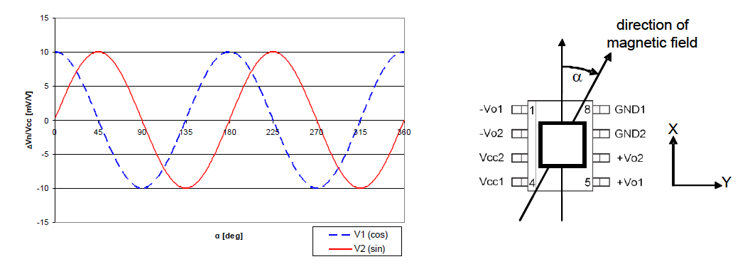
Principle of Traditional Solutions
What is common in competitors’ magnetic sensors?
Based on two components (X,Y) voltage measurement
Voltage is converted to digital domain
Angle is computed with complex arctan algorithm

Slide 8
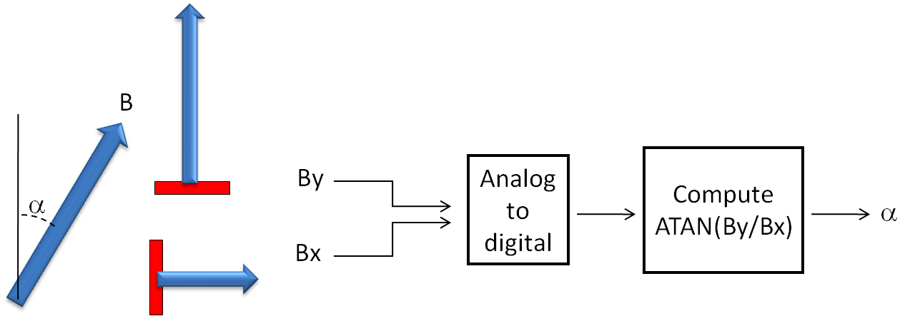
Principle of Traditional Solutions
Limitation of competitors’ traditional solutions?
Latency
Non-linearity
Cost vs resolution
Size
Current consumption
Latency
Non-linearity
Latency
MCU loading

Slide 9
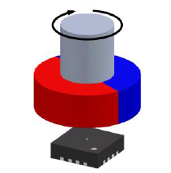
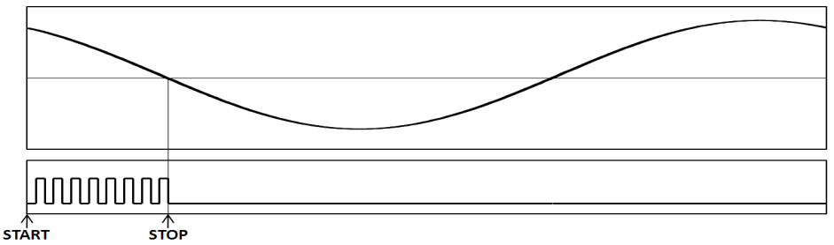
Basic Principle of MPS Angular Sensors
MPS unique solution of Spinaxis:
Instead of using digitized amplitudes.
We measure the angle by phase detection.
B
Phase
Detect
α
t
α
3~10us latency
8~14-bit resolution
Up to 1MHz refresh rate

Slide 10
Basic Principle of MPS Angular Sensors
i
V ∝ B⊥
V

Slide 11
Basic Principle of MPS Angular Sensors
How does Spinaxis work?
α
α
Filtered output

Slide 12
Basic Principle of MPS Angular Sensors
How does Spinaxis work?
α
COMP
HALL
REF
COMP
REF
PWM

Slide 13
Interface of MPS Angular Sensors

Slide 14
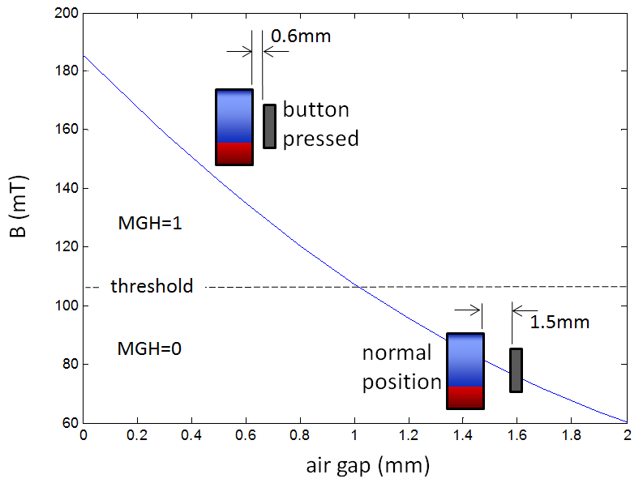
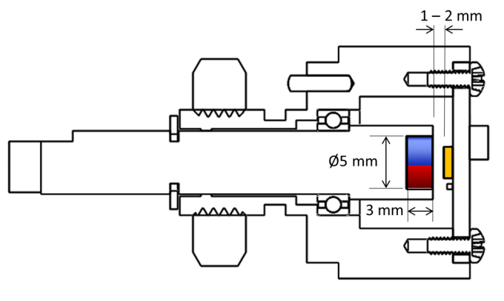
Field Strength Detection
Two independent detection thresholds MGH/MGL
Thresholds configurable between 15~150mT
Output pins and register flags

Slide 15
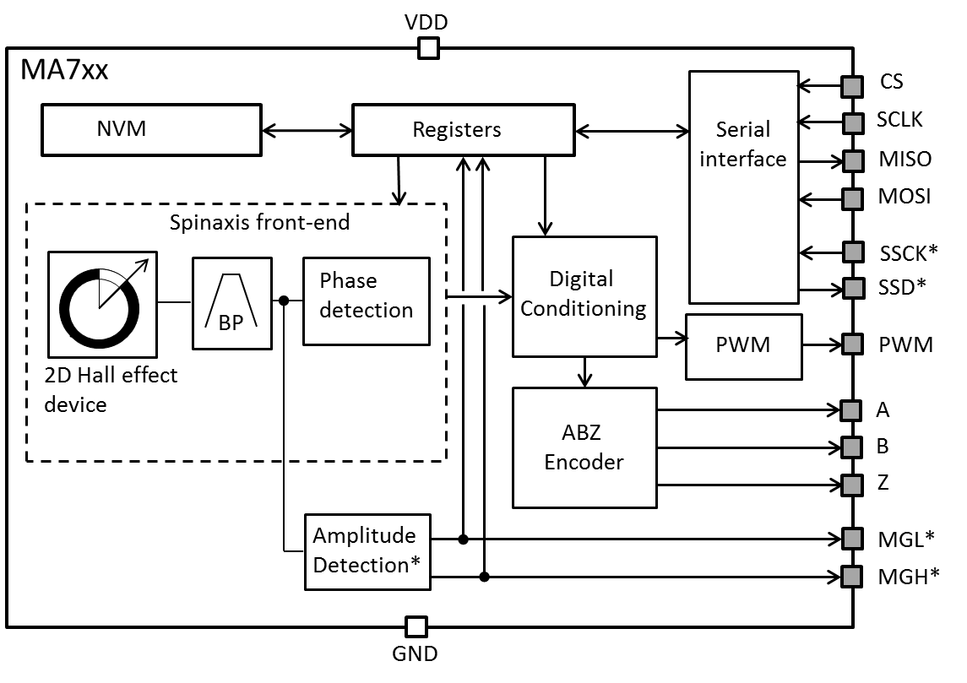
MA732/MA730/MA710/MA702 Introduction
SPI & SSI
9-14 bit absolute output
PWM Output
12-14 bit resolution
ABZ Incremental Output
10-12 bit resolution
Prog. 1-1024 pulses per turn
Prog. 4-4096 edges per turn
Field Strength Detection
Programmable high/low thresholds
Prog. Bandwidth(MA732)
Pin-2-Pin Compatible

Slide 16
MA7xx for Encoder Applications
Features by Part |  | Angular Sensors for Encoder Applications
 |  | MA702 | MA710 | MA730 | MA732
Effective angle resolution | bit | 12 | 12 | 14 | 9~14
Dynamic response |  | Fast | Medium | Medium | Fast
Magnetic field range | mT | 30 ~150 | 15~150 | 40~150 | 40~150mT
Zero setting |  | ✔ | ✔ | ✔ | ✔
Side-shaft compensation |  | ✔ | ✔ | ✔ | ✔
Adjustable direction |  | ✔ | ✔ | ✔ | ✔
SPI register configuration |  | ✔ | ✔ | ✔ | ✔
Absolute angle on SPI | bit | 12 | 12 | 14 | 9~14
Absolute angle on SSI | bit | 12 | 12 | 14 | 9~14
ABZ incremental |  | ✔ | ✔ | ✔ | ✔
ABZ resolution | PPR | 1~256 | 1~256 | 1~1024 | 1~1024
Adjustable Z pulse |  | ✔ | ✔ | ✔ | ✔
PWM output |  | ✔ | ✔ | ✔ | ✔
PWM resolution | bit | 12 | 12 | 14 | 14
Magnetic field detection |  | ✔ | ✔ | ✔ | ✔

Slide 17
MA1xx/MA3xx for Motor Applications
Features by Part1 |  | Angular Sensors for Motor Applications
 |  | MA102 | MA302 | MA310 | MA330
Absolute angle on SPI | bit | 8 | 12 | 12 | 9~14
Dynamic response |  | Fast | Fast | Medium | Fast
Magnetic field range | mT | 30~150 | 30~150 | 15~150 | 30 ~150
Zero setting |  | ✔ | ✔ | ✔ | ✔
Side-shaft compensation |  | ✔ | ✔ | ✔ | ✔
Adjustable direction |  | ✔ | ✔ | ✔ | ✔
SPI register configuration |  | ✔ | ✔ | ✔ | ✔
ABZ incremental |  |  | ✔ | ✔ | ✔
ABZ resolution | PPR |  | 1~256 | 1 ~256 | 1~1024
Adjustable Z pulse |  |  | ✔ | ✔ | ✔
UVW output |  | ✔ | ✔ | ✔ | ✔
UVW pp per rev. |  | 1~8 | 1~8 | 1~8 | 1 ~8
Differential UVW |  | ✔
Magnetic field monitoring |  | ✔ | ✔ | ✔ | ✔

Slide 18
MA8xx for Turning Knobs
Features by Part |  | Angular Sensors for Turning Knobs
 |  | MA800 | MA820 | MA850
Effective angle resolution | bit | 8 | 8 | 8
Magnetic field range | mT | 30~150 | 30~150 | 30 ~150
Zero setting |  | ✔ | ✔ | ✔
SPI register configuration |  | ✔ | ✔ | ✔
Absolute angle on SPI | bit | 8 | 8 | 8
Absolute angle on SSI | bit | 8 | -- | --
ABZ incremental |  |  | ✔
ABZ resolution | PPR |  | 1 .. 64
PWM output |  |  |  | ✔
PWM resolution | bit |  |  | 8
Magnetic field detection |  | ✔ | ✔ | ✔

Slide 19
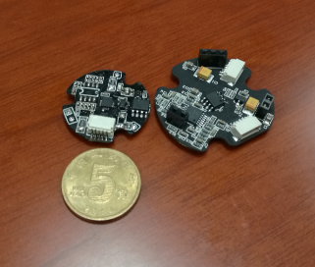
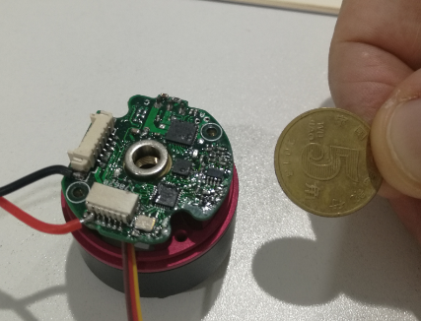
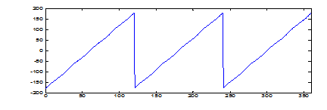
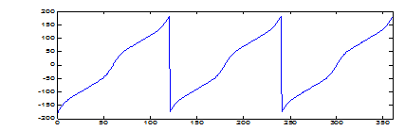
Application Stories Share
--MA730 for Gimbals
MA730
Sensor output with BCT trimming
Sensor output without BCT trimming

Slide 20
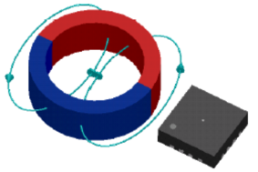
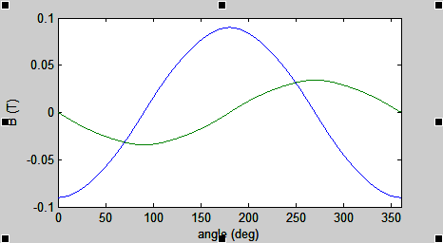
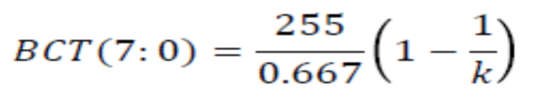
Application Stories Share
--MA730 for Side-shaft Gimbals
Simulation results of magnetic field:
Customer dimensions:
Bmin (mT) | Bmax (mT) | k
34 | 90 | 2.6
MagAlpha setting:
BCT=235

Slide 21
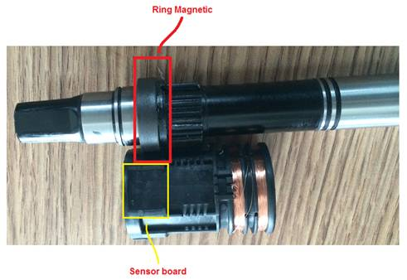
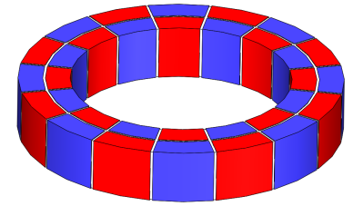
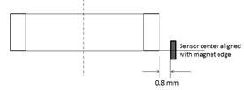
Application Stories Share
--Multi-pole Side-shaft for E-bike
Radial magnet
Results with 5-pp magnet:
MA7xx

Slide 22
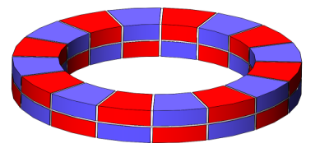
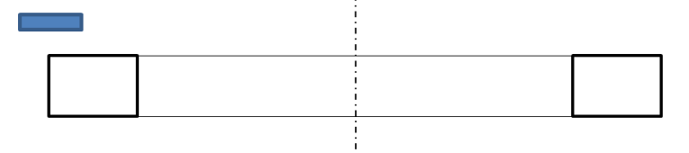
Application Stories Share
--Multi-pole Side-shaft for E-bike
Magnet:
MA7xx
Sensor position:
3D measurement at Sensima:
24-pp magnet

Slide 23
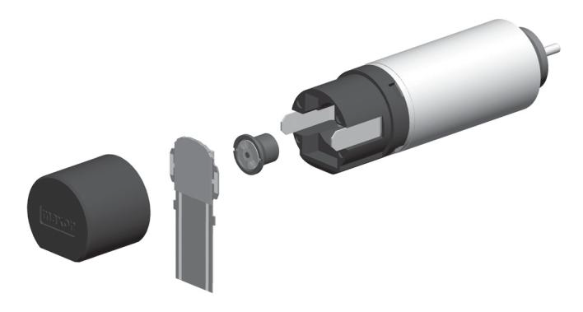
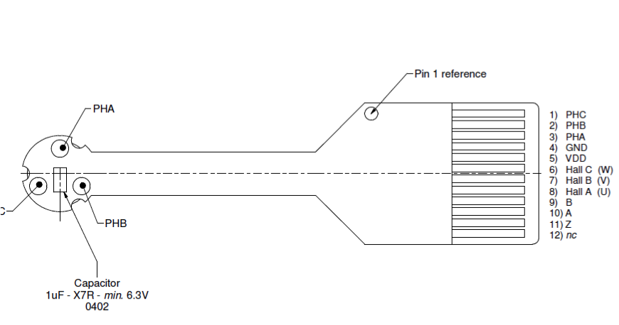
Application Stories Share
--MA302 for Mini Motors
Customer’s problem:
Motor diameter is too small for 3 hall ICs.
MPS Solution:
MA302
6mm outer diameter housing
4mm diameter magnet
In addition: provide encoder information

Slide 24
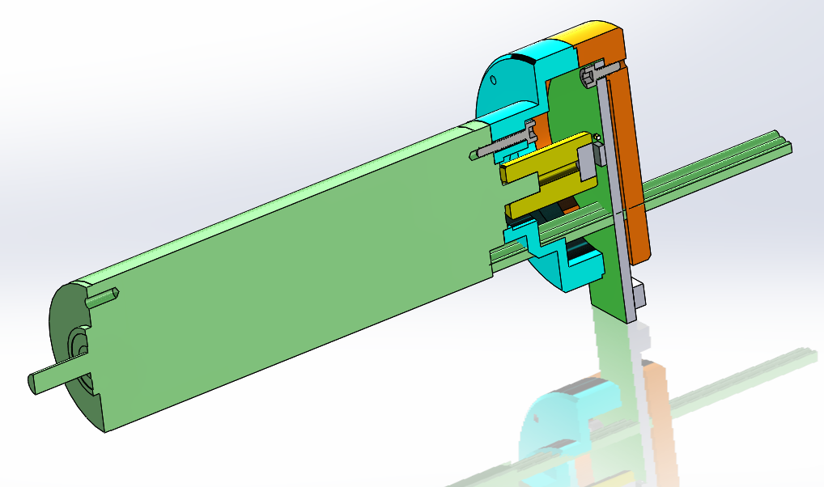
Application Stories Share
--MA702 for LV Servo Motor
Alum housing
MA702
4 mm diameter magnet
MA702 for optical encoder replacement
Lower cost, smaller size, higher reliability
encoder
hall

Slide 25
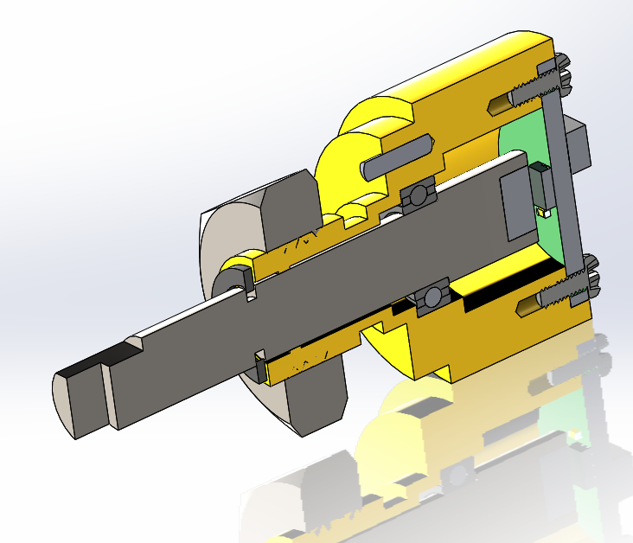
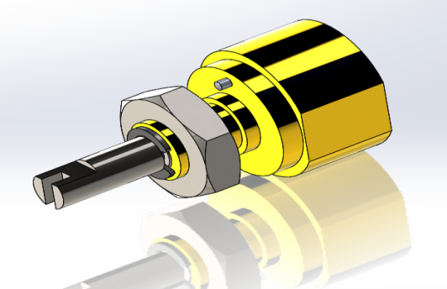
Application Stories Share
--MA850 for Turning Knobs
Alum housing
MA850
4 mm diameter magnet
encoder
MA850 for potentiometer/low-end rotate encoder replacement
Low cost, longer life, better performance, higher reliability

Slide 26
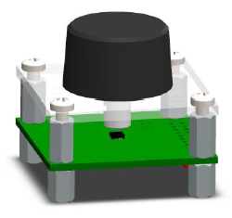
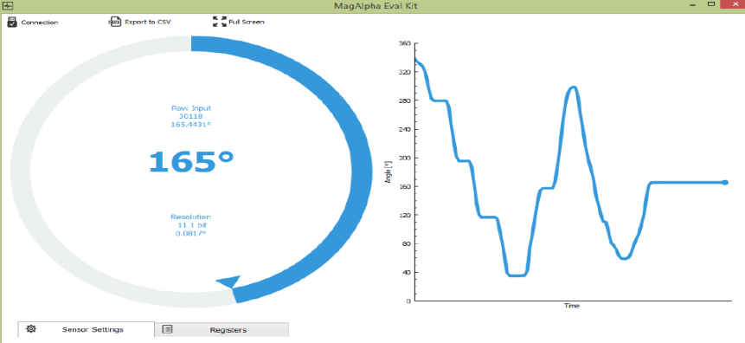
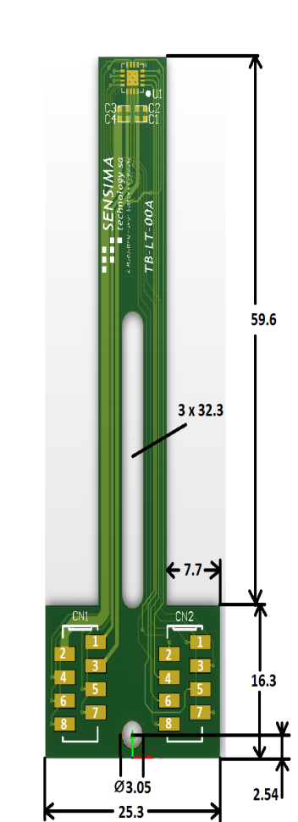
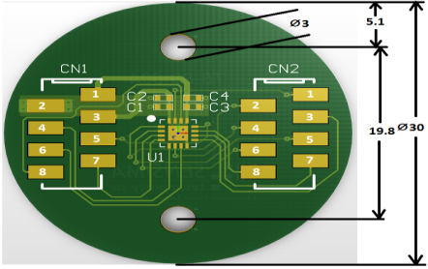
Demo & Test Boards
Rotary Knob Demo kit & GUI
Test boards for direct embedded via SPI

Slide 27
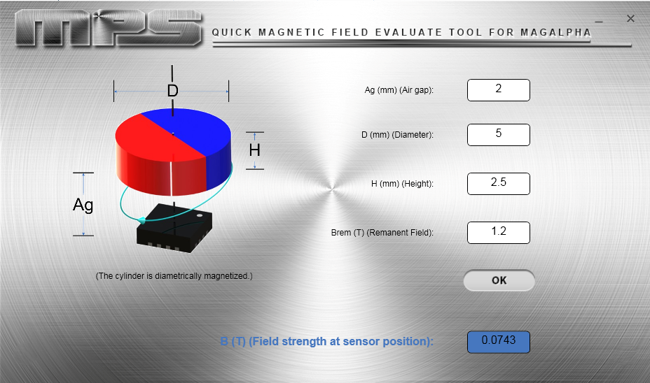
Offline Magnetic Design Tool
Magnetic field evaluation tool for end-of-shaft applications

Slide 28



Online Magnetic Design Tool
http://sensors.monolithicpower.com/
End-of-shaft
Side-shaft
Orthogonal Side-shaft

Slide 29




Online Magnetic Design Tool
http://sensors.monolithicpower.com/

Slide 30
Thanks~
http://www.monolithicpower.com/

