Slide 1
Smart Home Appliance Products and Solutions ShuZhuang Lv March 23, 2018

Slide 2
AGENDA
Diodes AC-DC Market and Product Portfolio Overview (Diodes电源市场及产品)
Diodes AC-DC Home Appliance Applications （Diodes家电市场应用）
Diodes Home Appliance Product Types （Diodes家电产品类型）
Traditional Home Appliance System Requirement (家电电源系统要求)
Detailed Products Portfolio-Traditional/IoT (详细产品分类表)
Traditional/IoT Power Product Solutions
Smart Speak System Requirement and Solutions (智能音箱电源方案)
AP39811A/B Applications for NI-MH Battery Shavers (AP39811A/B镍氢电池充电方案）
About Diodes
Page 2

Slide 3
About Diodes – Global IDM Manufacturer
Diodes 公司 (NASDAQ: DIOD) 为领先业界的高质量应用特定标准产品全球制造商与供货商，产品涵盖广泛领域，包括独立、逻辑、模拟及混合讯号半导体市场。Diodes 服务的市场包括消费性电子、计算机、通讯、工业及汽车市场。
Diodes 的产品包括二极管、整流器、晶体管、MOSFET、保护装置、特定功能数组、单闸极逻辑、放大器与比较器、霍尔效应与温度传感器、电源管理装置、AC-DC 转换器与控制器、DC-DC 开关与线性稳压器，以及电压参考与特殊功能装置。
产品聚焦于高成长终端用户设备市场，例如电视/卫星机顶盒、可携式 DVD 播放器、数据通讯设备、ADSL 调制解调器、电源供应器、医疗装置、个人计算机与笔记本电脑、平面显示器、数字相机、手机、AC-DC 与 DC-DC 转换器、无线 802.11 LAN 存取点、无刷直流马达风扇、序列连接及汽车应用。
Neuhaus, Germany
Packaging
Chengdu, China
Packaging
2
Oldham, UK
Wafer Fab
3
Jinan, China
Crystal Fab, Packaging
1
1
Shanghai, China
Wafer Fab
4
5
6
Kansas City, MO
Wafer Fab
2
Shanghai, China
Packaging
Jhongli, Taiwan
Oscillator Module Packaging
1
1
Page 3

Slide 4
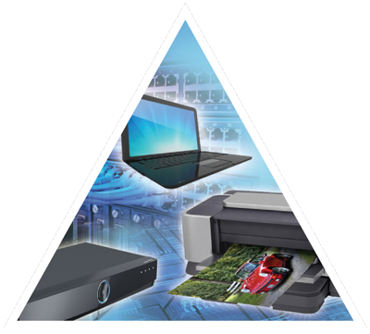
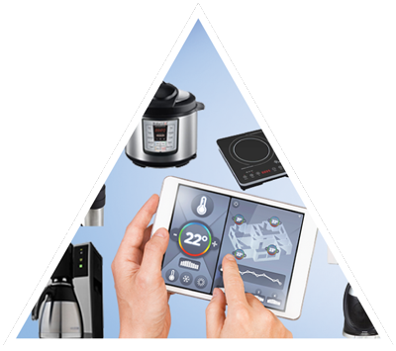
Diodes ACDC Product Portfolio
Premium Business Upgrade
New - 27W - 33W Premium Charger Solution (Proprietary Protocol, QC4/4+, PD 3.0 PPS)
15W – 18W QC2.0 /QC3.0, Proprietary Protocol Solutions -> PSR Cost-Down (15/18W) (AP3992+AP4375; GP5201+GP4373)
Business Expansion – Mid-Power
AP3108 -> AP3118 +APR348 USB PD NB
AP3125/AP3301 -> 31251/33011 STB/NetW
Quick Charging Solutions
C-to-C PD 3.0 Notebook Adaptors (45W-65W)
C-to-C PD 3.0 PPS /QC4/ 4+ / Premium Chargers (25-40W)
A-to-C Quick Chargers < 25W (Various Quick Charging Protocols)
Mid-Power
CCCV
New Mid-V PWM – AP3125/3301, AP31251/33011, PWM Switcher
15W+
Mainstream Chargers
Mid-Power Markets (STB, NW,NB, Printers)
Mainstream Business Further Business Expansion
Low Standby-Power 8W/10W Charger Solution (<10mW)
Cost-Effective 10W Charger Solution (<75mW)
Balance Business Development
8W/10W
Business Expansion - IoT/Smart HA
AP3983X
AP39811 / 3981X Flyback
AP3917X Buck
Business Foundation Regain Market Position
Volume Market Chargers
High-Frequency Lower System BOM Cost Drive –
5W Charger
3.5W Charger
Home App
Settop Box, Router
Smart Speaker
Smart Home Appliance Power
3.5W/5W
IoT / Smart Home Appliance Markets
Mobile Phone / Charger Market Segmentation
三大市场电源产品及方案
手机充电器
中功率
小家电
Page 4

Slide 5
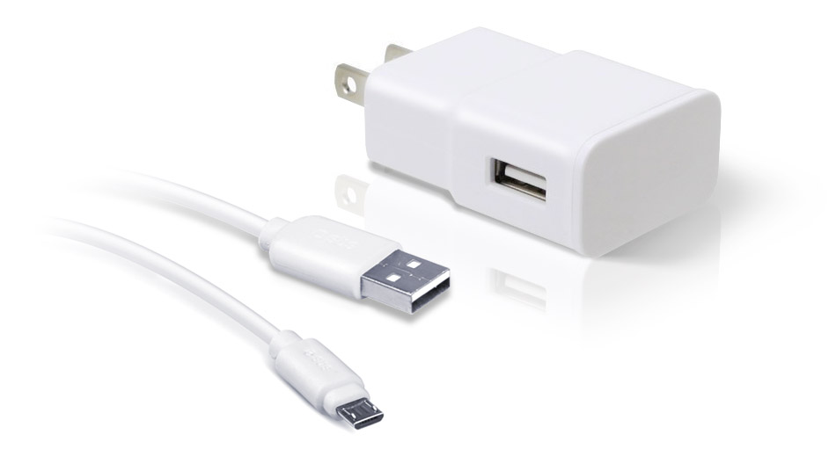
Complete Charger and Power Adapter Solutions
Market Trend
System Efficiency
New Technology
Standby Power
Cost
Secondary Rectifiers
Primary Rectifiers
PSR
Accelerator
AP434X
Schottky Diodes
Bridges
SBR®
Diodes
PSR Controllers / Switchers
Switches
Sync. Rectifiers
AP37XX/39XX
HV BJT
Diodes 电源平台整体方案
开关控制器
分立组件
Page 5
Notes:
With BCD acquisition, now we are able to provide complete charger and power adapter solutions
We continue working on improving system efficiency with new technology and reducing standby power and cost

Slide 6
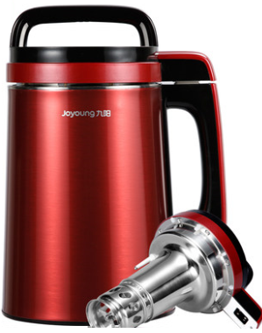

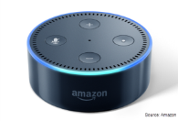
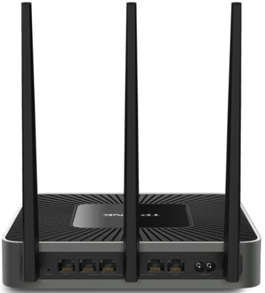

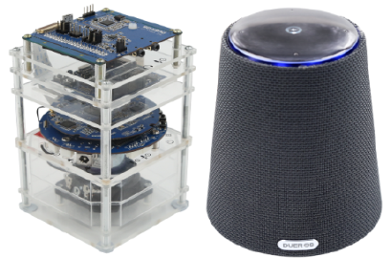
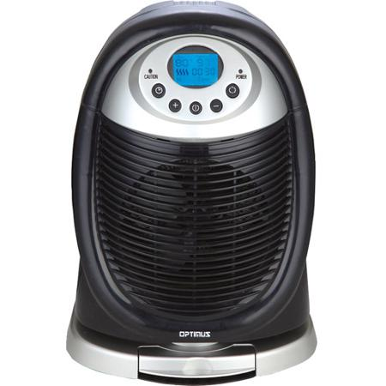
AC-DC Home Appliance Applications
Traditional / IoT Appliances
传统和物联网家电
Set-Top-Box
Network
网通，机顶盒
Diodes AC-DC Home Appliance Applications
Diodes 家电市场应用
AI Appliance
(smart IoT speakers)
智能音箱
Page 6

Slide 7
Home Appliance Key Products Types
PSR Controller
AP3785T
Buck Switcher
New
AP3771
AP3917B
AP3917C
AP3917D
AL17050
PSR Switcher
AP3984
AP3907
AP3983X
AP3983RX
Home Appliance Products
PSR Switcher
New
AP3981XT
AP3981XL
AP3981XC
AP39811A/B
AP3968/69/70
Isolated Solution
隔离方案
Non-Isolated Solution
非隔离方案
小家电产品: 基于PSR 架构的原边相关产品
NEW
Page 7

Slide 8
Smart Home Appliance System
System Requirements
Off-line Isolated Power Solutions:
Full load Power Ranges from 3W up to 20W (PSR and SSR Topology)
Non-isolated Power Solutions:
Full load Power Ranges from 0.5W~3W~8W (Buck Solution)
Desirable Feature Requirements –
Isolated Power Solutions with Adapter Types - DOE6 and DOE5 六级和五级能效方案
Non-isolated Power Solutions with Open frame types - Loose conversion efficiency spec.
Low Standby Power: <75mW, <100mW, <500mW
High Integration Solution - Built-in MOSFET and No startup resistor (JFET types)
Harsh Operation Environment - 恶劣的使用环境 (high temperature and humidity)
High Over Current Spec - up to 200% of rated output current for motor machine.
Current Power Solutions
5W - AP3968 /AP3983B/AP3984 (SO-7, PSR Switcher, Off-line Isolated Solution)
8W - AP3983C (SO-7, PSR Switcher, Off-line Isolated Solution)
12W/18W - AP3970/71/AP3983D/E (DIP7/SO-7, PSR Switcher, Off-line Isolated Solution)
36W - AP3103/AP3125 (SSR Controller) + External Mosfet
Page 8

Slide 9
Detailed Products Portfolio – Traditional/IoT
Buck Switcher
Part Number | Application | Start-Up Current | UVLO Threshold on/off (V) | RDS,ON (ohm) | Peak Current (mA) | Standby Power (mW) | Power Rating (W) | Package
AP3917B | Small Appliance /IOT | 10 | 8.0/8.3 | 16 | 170 | < 30/75 | 2 | SO-7
AP3917C | Small Appliance /IOT | 10 | 8.0/8.3 | 12 | 270 | < 30/75 | 4 | SO-7
AP3917D | Small Appliance IOT | 10 | 8.0/8.3 | 10.5 | 370 | < 30/75 | 6 | SO-7
AL17050 | Small Appliance IOT | 5 | 5.3/5.6 | 30 | 220 | < 30/75 | 0.5 | SOT23-5
PSR Switcher
Part Number | Application | Start-Up Current | UVLO Threshold on/off (V) | Operating Current (µA) | Cable Compensation | MOSFET / BJT | Power Rating (W) | Package
AP3981ET | 15W Adapter | 1 | 16/4.3 | 465 | 6% | 700V/5A MOS | 15 | SO-7
AP3981EL | 15W Adapter | 1 | 16/4.3 | 465 | 6% | 700V/5A MOS | 15 | SO-7
AP3981EC | 15W Adapter | 1 | 16/4.3 | 465 | ADJ | 700V/5A MOS | 15 | SO-7
AP3981DR | 10W Adapter | 1 | 16/4.3 | 465 | ADJ | 700V /4A MOS | 10 | SO-7
AP39811A/B | 7.5W Adapter | 0.2 | 15.0/7.0 | 550 | 0.6V | 650V /1.5A MOS | 7.5 | SO-7
AP3984 | 5W Adapter | 0.2 | 13 / 4.6 | 650 | ADJ | 700V/1.5A BJT | 5 | SO-7
AP3983B/C | 7.5W/10W Adapter | 0.2 | 15.5 / 6.8 | 650 | 6% | 650V/1.5A/2A MOS | 7.5/10 | SO-7
AP3983EC | 15W Adapter | 0.2 | 15.5 / 6.8 | 700 | 6% | 700V/5A MOS | 15 | SO-7
AP3983DC | 12W Adapter | 0.2 | 15.5 / 6.8 | 650 | 3% | 700V/4A MOS | 10 | SO-7
Page 9

Slide 10
AP3981XT/XL/XC Adapter Product Features
Description
AP3981XT/XL/XC are high performance power switchers integrated with a primary side regulation controller and MOSFET. These ICs are easy to achieve better IV curve without an opto-coupler and secondary control circuitry.
The AP3981XT/XC/XL operate in Pulse Frequency Modulation mode and peak current amplitude modulation mode to form a fine tune frequency curve within the whole power range. Therefore, the ICs can achieve both high average efficiency and avoid audible noise.
The AP3981XT features accurate external OTP protection by NTC resistor that are especially important for smart speakers; The AP3981XL features accurate line voltage protection to meet OLP for unstable high input voltage areas. The AP3981XC with external resistor are used to match different output cable.
.
Diodes Features
650V/700V MOSFET
Multiple AM/PFM Control Mode to Improve Audio Noise and Efficiency
Meet Efficiency Norm of CoC Tier and EPS6.0
Frequency Jitter to Improve System EMI
Lower No Load Input Power :30/75mW
Rich Protection: OTP,OLP,SCP
Accurate Adjustable OTP and OLP
AP3981CT/CC/CL for 6W Output
AP3981ET/EC/EL for 15W Output
Applications for STB and Network Adapters
Part Number | Features
AP3981XT | Adjustable OTP
AP3981XC | Adjustable Cable Comp.
AP3981XL | Adjustable Line Voltage

Slide 11
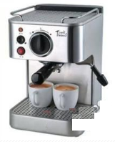


AP3981XT/XL/XC Adapter Product Solutions
5W-15W Cost-Effective PSR Switcher Solutions
输出特性曲线
路由器 智能插座
机顶盒 STB
咖啡机

Slide 12
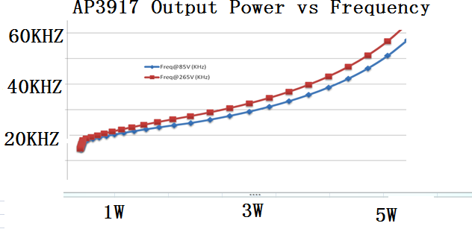
AP3917B/C/D Buck Product Features
Description
AP3917B/C/D are universal AC high voltage input step down regulator that provides accurate constant voltage (CV) and outstanding dynamic performance without requiring an opto-coupler. The main applications are especially for home appliance and IoT applications with non-isolated buck solution or offline flyback power solutions.
Working with a single winding inductor and integrating a 650V/700V MOSFET internal can make it use fewer external components and create a low bill of material cost solution.
The AP3917B/C/D has rich protection features to enhance the system safety and reliability. It has Over Temperature Protection, Vcc Under Voltage Lock function, Output Short Protection, Over Load Protection and Open Loop Protection
Diodes Features
650V or 700V MOSFET
Typical Peak Current:
170 mA /270mA/370mA for AP3917B/C/D
Up to 2W/4W/6W Output Power
Improved Constant Voltage: ±5%
Lower No Load Input Power :30/75mW
Rich Protection: OTP,OLP,SCP
Applications for most small appliances
SO-7 Package
Part Number | Peak Current (mA) | Output Power (W)
AP3917B | 170 | 2
AP3917C | 270 | 4
AP3917D | 370 | 6

Slide 13
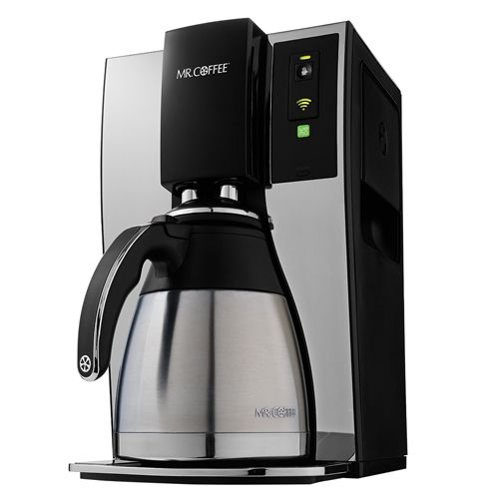
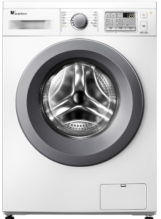
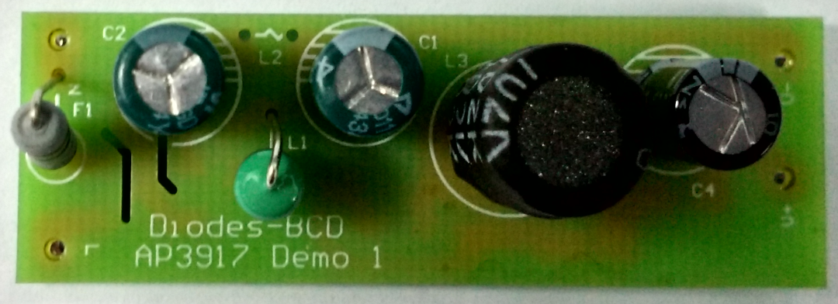
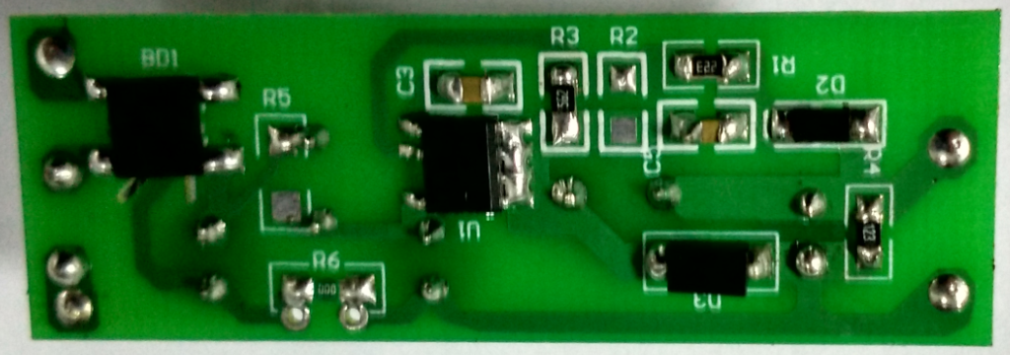
AP3917B/C/D Buck Solution-Single Output
交流风扇
AC Fan
洗衣机
Page 13

Slide 14
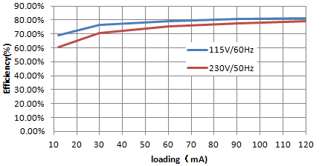
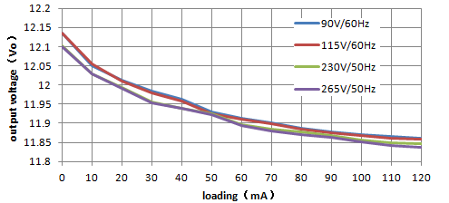
AP3917B Schematic Diagram & Test Results
For <25mW 待机
12V/0.15A效率-负载曲线
12V/0.15A电压-负载曲线

Slide 15

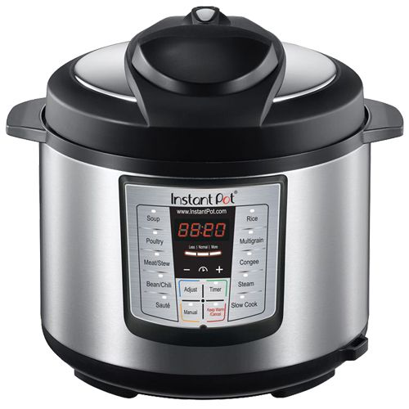
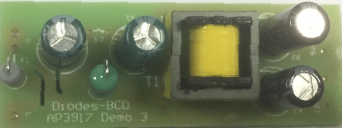
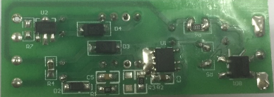
AP3917B/C/D Buck Solution-Dual Output
电磁炉
Induction Cooker
Page 15

Slide 16

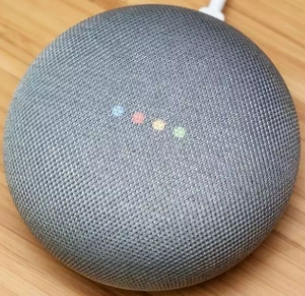
Smart Speaker Systems Requirement (高端)
System Requirements -
Voice-Input, AI-based Cloud Service IoT Smart Speakers
Full load Power Ranges from 5W up to 40W (PSR and SSR Topology)
Desirable Feature Requirements –
Low Standby-Power /Light Load High Efficiency - IoT
devices (wireless connectivity might be always ON)
High degree of integration for Limited PCB Space
Protection Requirements - Precision Over Temperature Protection, OVP
Support Surge of Power requirements (Peak Loading)
Cost-Effective System BOM
Current Power Solutions -
5W - AP3907 (SO-8, PSR Switcher, DCM Mode, 5V Output)
9W - AP3785TA (SO-8) +APR34309C (SO-8EP) (PSR Controller, SR Switcher, 5V Output)
12W - AP3785TA (SO-8) +APR34250 (SO-8) (PSR Controller, SR Switcher, 12V Output)
15W/21W - AP3125ST (PWM Controller, SO23-6,12V output)
(Amazon Dot/Echo/Show,5V/1A)
(Google Home Mini,5V/1.8A)
Page 16

Slide 17
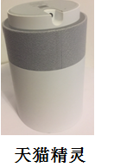
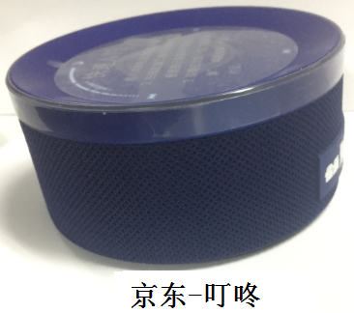
Smart Speaker System Requirement (中端)
System Requirements -
Voice-Input, AI-based Cloud Service IoT Smart Speakers
Full load Power Ranges from 5W up to 40W (PSR and SSR Topology)
Current Power Solutions -
7.5W - BJT Solution
12W - MOSFET Solution
21W - MOSFET Solution
智能音箱主要品牌 | 产品系列 | 智能助手 | 电源规格
阿里巴巴 | 天猫精灵 | 天猫精灵 | 12V/1A
京东 | 叮咚 | 叮咚叮咚 | 5V/1.5A
小米 | 小米AI音箱 | 小爱同学 | 12V/1.75A
(阿里巴巴品牌)
制造商对电源指标没有苛刻的要求，
要求待机小于2W (天猫精灵，实测偏大)
天猫精灵接受高规格
的要求
(科大讯飞与京东合资)
Page 17

Slide 18
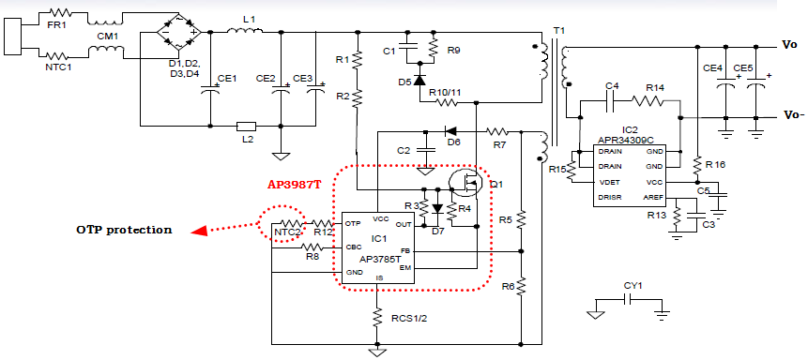
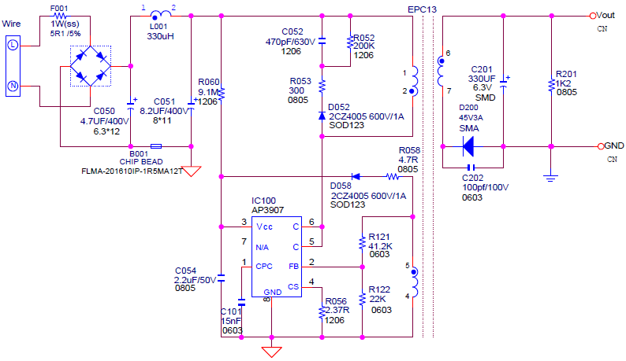
Smart Speaker Systems Schematics
Amazon, AP3907 5V/1A, 75mW
Built-in Precise OTP
Google, AP3785T 5V/1.8A, 10mW
External Precise OTP
New Features are still evolving
Primary/secondary side Latch,
Accurate OTP, etc.
Amazon, AP3125ST 12V/1.2A, 75mW
External Precise OTP
Page 18

Slide 19
Future Product Migration Plan – Smart Speakers
Integration
Peak Load
30mW STB
AP310X (SO-7)
Peak Load,30mW standby power
AP3125ST (SO23-6)
External OTP, accurate OVP
AP3126X (SO23-6)
External OTP, Peak load
SSR
15W/+
AP3785TA(SO8) + APR34309C (5V Output)
AP3785TA(SO8) + (APR3432)/AP34250 (12V Output )
Low-Standby Power PSR Controller (<10mW), External OTP
Integration Power mos
PSR
AP3987TA + APR34309C (5V Output)
AP398XTA + AP34250 (12V Output )
Low-Standby Power PSR Switcher
(<10mW), External OTP
Power Range / System BOM $
10W
5W -12W
AP3981XT + Diodes (5V~12V output)
Low Cost Power PSR Switcher
(<40mW), External OTP
AP3907 (SO-8,5V Output)
PSR Switcher (75mW Standby Power),
5W
More evolution for new derivative products
are expected
AP3984 (SO-8,5V Output)
PSR Switcher (10mW Standby Power),
Current Products
Q1 2018
Q2 2018
Q3 2018
Page 19

Slide 20
AP39811 Shaver Application For NI-HI Battery
Description
AP39811A/B are PSR power switchers with built-in 650V MOSFET, and its target market
Is Shaver with slant IV curve. A resistor connected between FB Pin and CPR Pin is introduced to adjust the slew rate of the slant
IV curve.
The AP39811A/B operate in Pulse Frequency Modulation mode and peak current amplitude modulation mode to form a fine tune frequency curve within the whole power range.
The AP39811 A/B provide comprehensive protections without additional circuitry. It contains Vcc over voltage protection, output over voltage protection, XFMR anti-saturation protection, bulk-cap open protection, open loop protection, OTP, etc.
The AP39811A/B is available in SO-7.
Diodes Features
650V/1.5A MOSFET
Multiple AM/PFM Control Mode to Improve Audio Noise and Efficiency
Meet Efficiency Norm of CoC Tier and EPS6.0
Slant IV Curve
Lower No Load Input Power :75mW
Rich Protection: OTP,OLP,SCP
AP39811A/B for 7.5W Output
Applications for NI-MH Battery Shavers
SO-7 Package
剃须刀 Shaver
Page 20

Slide 21
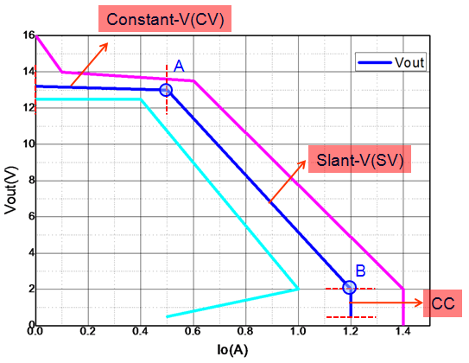
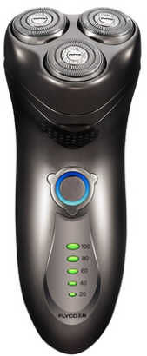
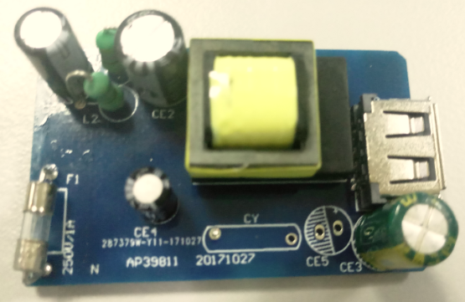
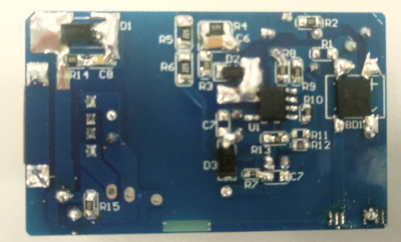
AP39811A/B Shaver Application
Page 21

Slide 22
Conclusions – Diodes Value Proposition
多年来AC-DC开关电源产品已奠定深厚技述及产品的基础
AC-DC生意基础以手机充电器及适配器的基础， 积极拓展小家电电源产品及方案
小家电电源, 以隔离及非隔离拓朴价构， 提供适用功率范围的产品及方案
小家电电源产品系列， 以变频变峰值电流设计， 以实现低待机及轻载高效
小家电电源产品系列含， AP3983X (Flyback), AP3981X (Flyback), AP3917X (BUCK)
提供完整的电源分立元件及模拟元件， 简化客户采购作业
秉持对客户的承诺 在小家电电源产品， 作到高品质， 高性价比及技术服务
Page 22
Notes:
一

Slide 23
Notes:
23

