Slide 1
Power Tools
Steven Li
Oct 2017

Slide 2
Littelfuse Overview

Slide 4

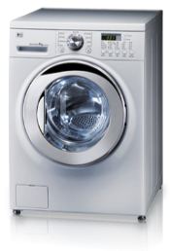


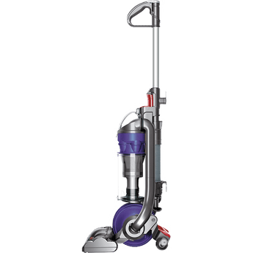

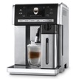

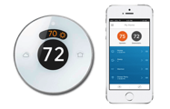
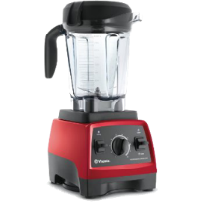
Protect Ι Control Ι Sense — A Global Approach
Protect
Today’s sophisticated electronics require greater protection from ESD, power surges and other occurrences
Handle more power in smaller products
Innovative circuit protection solutions
Control
Safely and efficiently control power in even the harshest environments
Limit equipment damage and minimize electrical hazards
Improve productivity and reduce costs
Sense
Sensing technologies are increasingly used to support complex electronic systems
Broad platform of technologies help improve product performance, comfort, convenience and safety

Slide 5
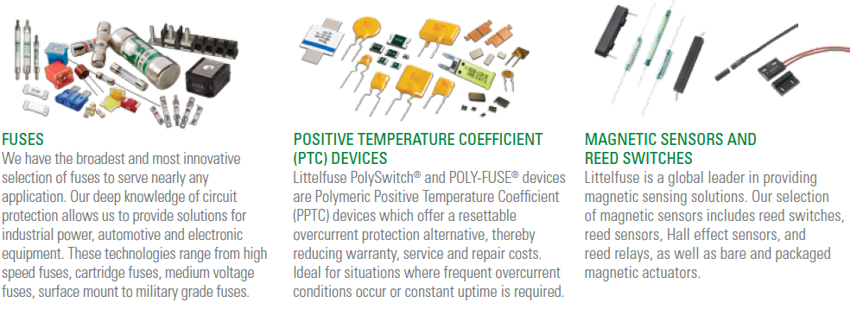
Product Portfolio

Slide 6
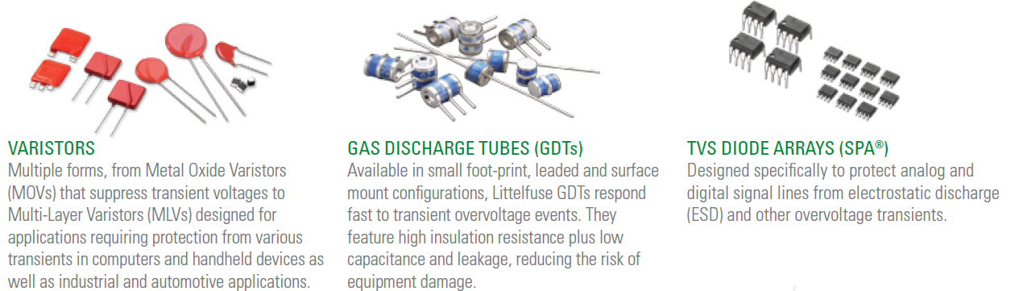
Product Portfolio
http://www.littelfuse.com/about-us/business-overview-video.aspx

Slide 7
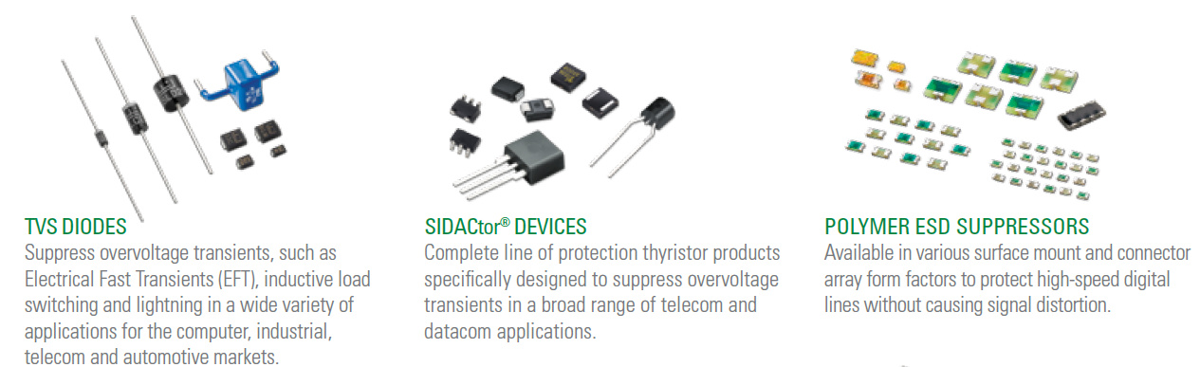
Product Portfolio

Slide 8
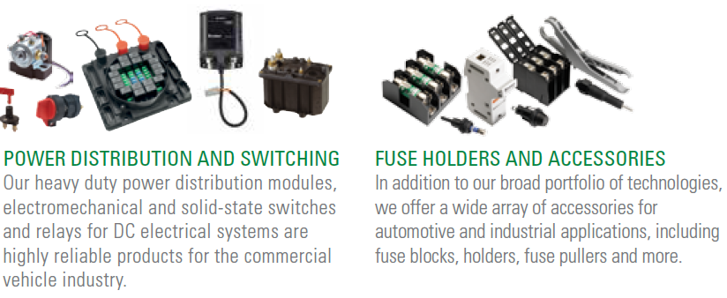
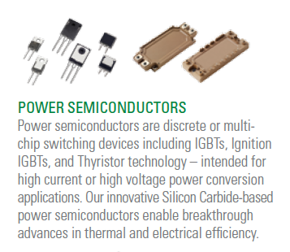
Product Portfolio

Slide 9
Power Tools Class

Slide 10

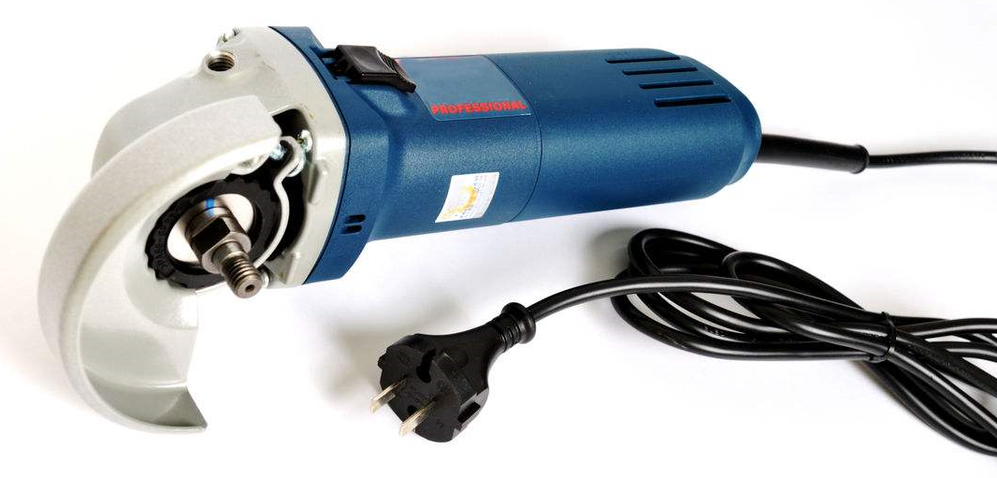
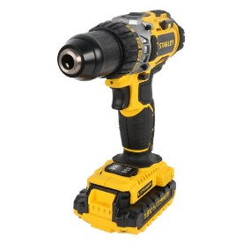
Hand-Held Electric Motor Operated Tools (IEC60745-1/GB3883-1)
Power Tool by Electrical Protection Mode:
Class I Tool: conventional electric tools,rated voltage exceed 50V. Plug for single phase 3 wires plug type tool.
Class II Tool:electrical tools with double insulated structures. Rated voltage exceed 50V.Class II Tool has no grounding system with insulated enclosure design.Plug for 2 wires plug type tool. More Popular
Class III Tool: A safety voltage tool. Rated voltage is less than 50V.

Slide 11
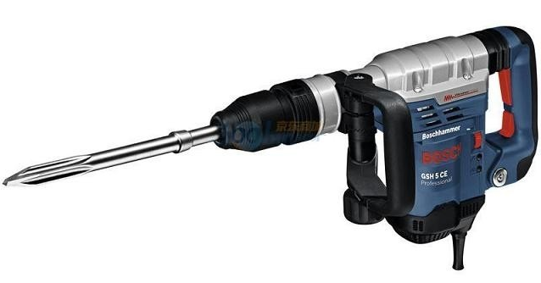
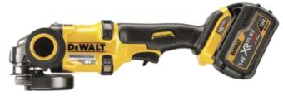
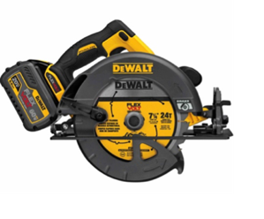
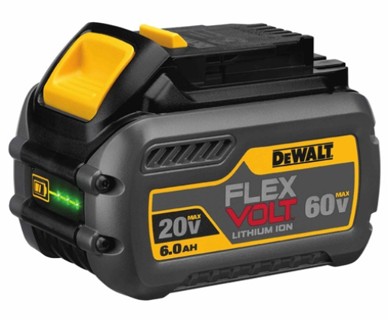
Wide range of protection & sensing solutions addressing portable & robotic devices
With Wire
Charger
FlexVolt 20 to 60V
Charger or With Wire
Battery & BMS
Functional Unit
AC power compliance & safety
Safety interlock solutions (magnetic)
DC interface surge protection
ESD protection of displays/indicators
Disconnect on demand for without wire *
DC power protection (OC & OV)
Charger–Battery com. Line (CAN Bus) protection
Battery sense/balance line protection
Safety interlock solutions (magnetic)
Module/Cell critical OT detection*
Cell level overcurrent (OC) protection*
ESD protection of displays/indicators
Disconnect on demand *
Magnetic speed sensors
Magnetic trigger mechanisms
Power MOSFET thermal protection
DC Motor Protection
AC Motor Phase Control
ESD protection of user interfaces
Over-temperature (OT) indicators*

Slide 12

Littelfuse has solutions for all functional blocks of power tools device
Charger or With Wire
Battery Pack/BMS
Battery
Pack S/P
Power
Control
Unit CC/CV
T°
T°
L
N
G
Sensing lines
Sn
Cell
Voltage/
Temperature
Monitoring
Balancing
Intput
Sn-1
S1
Power Supply
Output
LED indicator
LED indicator
Chipset
AC or DC motor drive
User Interface
Power Supply
ON/OFF Trigger
Motor
Motor
Drive
Gate
Driver
MCU
Control
Continuous Trigger
T°
T°
Displays/Indicators
LED Driver
LED Lights

Slide 13
Power Input Unit

Slide 14
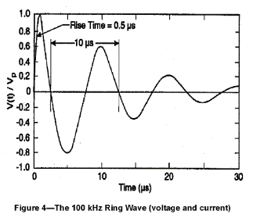
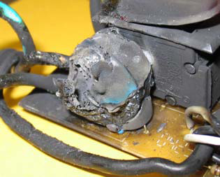
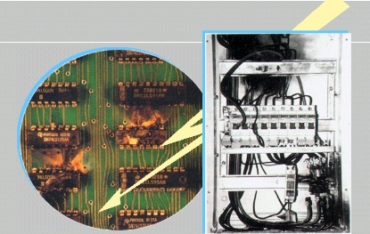
Power Face OV threat
Overvoltage Sources in Power System
Lightning induced Transient
Power Internal Sources(include
Power Fault Event,GPRs, Surge Coupling ect)
Overvoltage Cause potential damage
System abnormal working
System damage
Load fault or damage
Potential personal injury

Slide 15
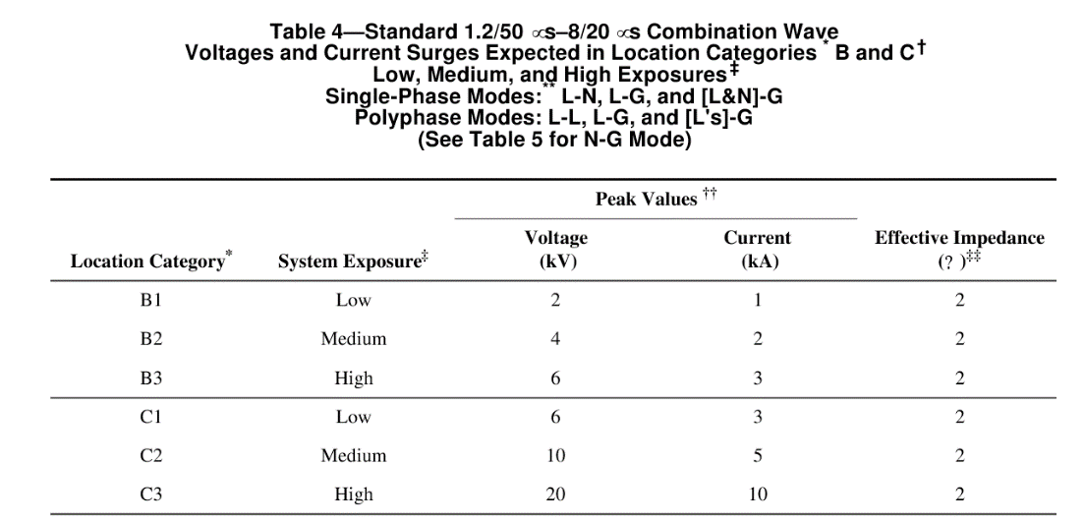
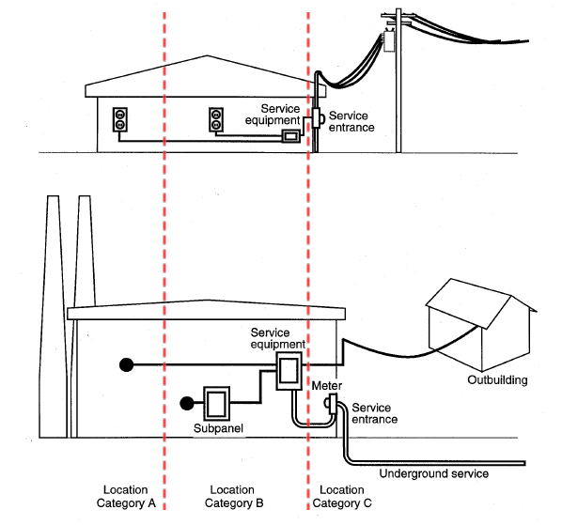
(with reference to IEEE C.62.41-2002)
Power meet surge protection standard
Category A: parts of the installation at some distance from the service entrance
Category B: Between Cat A and Cat C
Category C: External part of structure, extending some distance into the building.

Slide 16
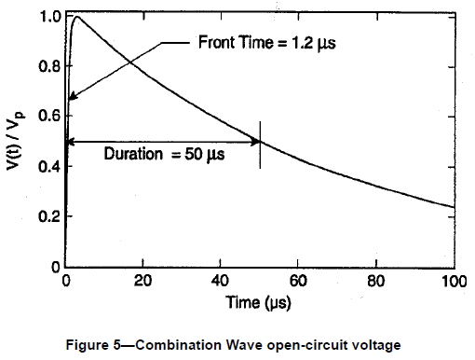
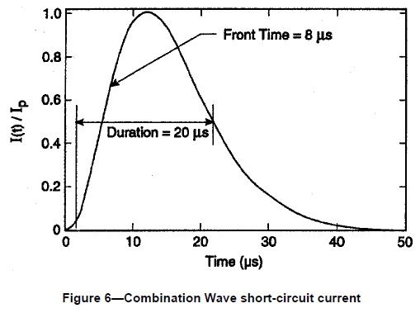
IEC61000-4-5 Standard
1.2/50us Voltage Waveform
8/20us Current Waveform

Slide 17
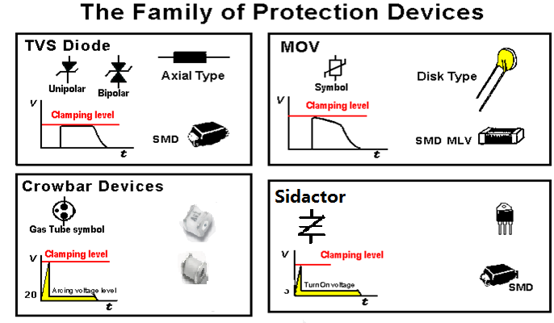
Overvoltage Product Family

Slide 18
GDT/SIDACtor/MOV/TVS comparison
Technology
SIDACtor
GDT
MOV
TVS
Response Time
Fastest
Slowest
Slower response time
Fast
Capacitance
Low
As low as 1pF
High
Higher
Current surge rating
High
As high as 500A for 200 impulses
High
Low
Electrical Characteristic
Stable
Degrade with time
Fatigue after multiple pulses
Stable
Application
Principle over-voltage in telecom, datacom circuit
Telecom applications
Useful in AC applications
Secondary protection

Slide 19
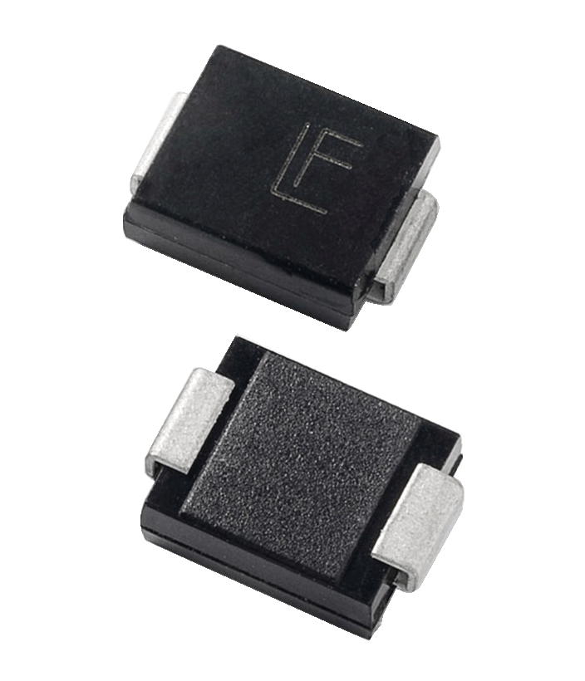

CC/CV charger(Without Wire)
Charger
+V
AC Input
Protection
1
Snubber
2
2
L
N
G
-V
3
ID
Input Connector
PWM
Controller
Fault detection
I/O Connector
MCU
Charger
Sensing lines
T°
LED indicator
1
2
3
Technology | Series
Fuse | 835, 215 Series , TR5 Series(382)
MOV | TMOV, UltraMOV
Technology | Series
Diode | DSTxxxC MBRF10xxCTL
Technology | Series
TVS Diode | SMAJ, SMBJ

Slide 20
OC/OV Unit with Wire
120Vac/220Vac
Input
Voltage
2
DC Brush or Brushless Motor Drive
Input Connector
1
L
N
Cable
or
3
PE
EMI
Filter
OC/OV
Rectifier
PFC
1
2
3
Technology | Series
Fuse | 835, 215 Series , TR5 Series(382)
MOV | TMOV, UltraMOV
GDT | CG3 OR DC Spark 470V
Technology | Series
Diode | DSTxxxC MBRF10xxCTL
Technology | Series
TVS Diode | SMBJ, SMCJ

Slide 21
Battery Pack protection

Slide 22
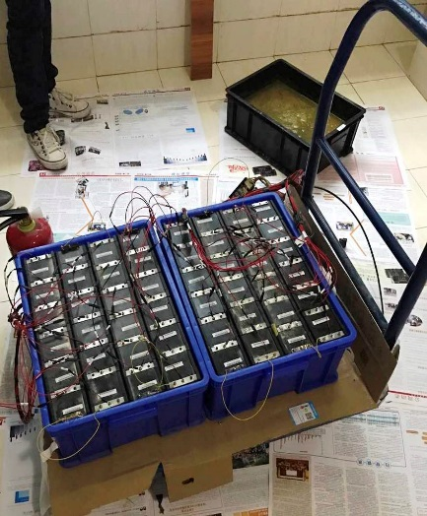
BMS Sense Line face Risk
Consider Battery Pack Assembly and Application Scene.
e.g. Sense line short at Test Assembly
e.g.Wire Harness Wear
e.g.Pack water seepage
That could cause the C0(highest voltage Line) and Cn(Lowest voltage Line) short.That means huge risk to Battery Pack.
Thus,BMS will perform the worst test---Wire harness put in salt water---once C0 and Cn line shot,Battery Pack will explode
Salt Water

Slide 23
BMS Component failure => Battery Pack Thermal runaway
Certain failures associated with external components can lead to unsafe conditions in electronic modules. A good example of this, is component that is connected between high energy signal source failing short . Such kind of condition can easily lead to the component overheating and damaging the board and other components in its proximity. One area to consider with BMS design, is the capacitors are normally protected by series protection resistors but could present a safety hazards in event of dual point of fault where both capacitors and associated series resistors fail short . In some cases, common mode capacitors are directly connected to cell without series resistance for EMI purpose optimization , in this case a single fault event could lead to catastrophic damage on BMS. A dual point of failure in balancing resistance and associated Balancing MOSFET could also rise to a shorted cell condition .
SMD fuse in series with sensing lines must be located as close as possible to the input connector . In case of single short circuit or dual point of fault event, the the voltage across fuse can be as much as 12 to 14 cells in series which usually below 60V .
Lithium-ion Battery chemistry is highly temperature sensitive , due to the proximity of BMS board and battery pack , any potential overcurrent or overload condition on BMS board can lead to local overheating or hot spot , therefore upstream fuse protection must be considered regarding safety standpoint

Slide 24
Several failure modes need to be considered when implementing battery safety circuitry
Fault causes
Li –ion battery
Fault manifestation
Littelfuse risk reduction
Short circuit or fast charging
Electrical overstress
Cell venting
Over temperature
External thermal stress
Uncontrolled thermal event
Vibration, Shock & Drop
Mechanical stress
Mechanical failure
Internal battery cell defects can amplify any & all battery stress factors
Note: In some cases it can be very difficult to identify manufacturing defects as part of standard quality control processes.

Slide 25
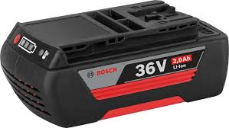
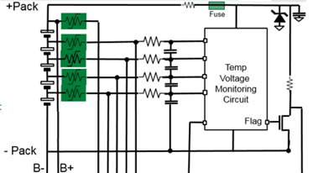
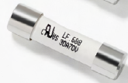
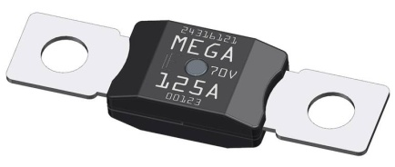
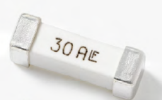
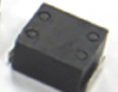


Battery pack protection & BMS
1
2
Battery Pack High current fuse
Battery Com. Line ESD Protection
IC Transient spike protection with TVS diode
1
Technology | Series
Fuse | 688 series or Mega Series base
SMD Fuse | 881 Series 1206SFH 463 Series
2
Technology | Series
TVS Diode | SMF,SMAJ, SMBJ
BDU
3
3
Technology | Series
BMS Com Line | SPA(SM24CAN)
High or low power path, protection is needed to meet safety requirements

Slide 26
AC /DC Motor protection

Slide 27
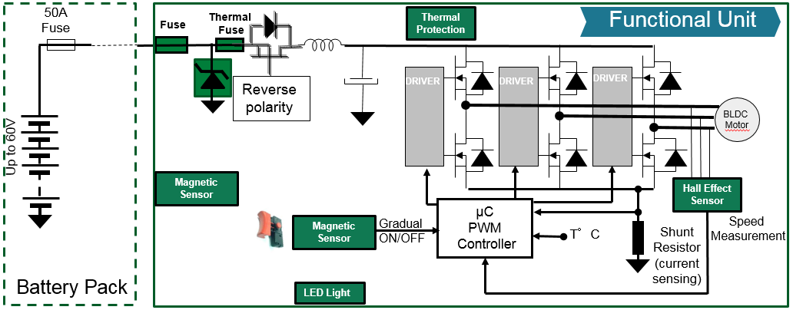
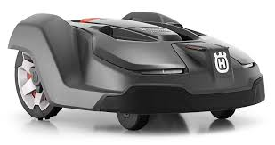

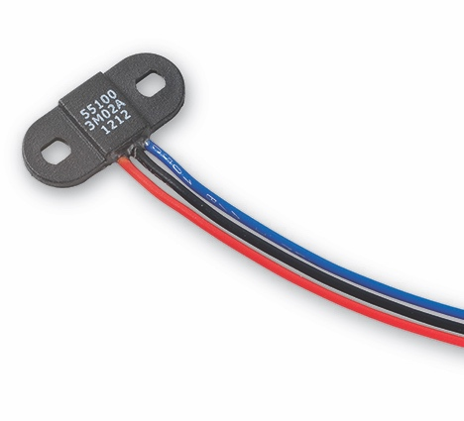
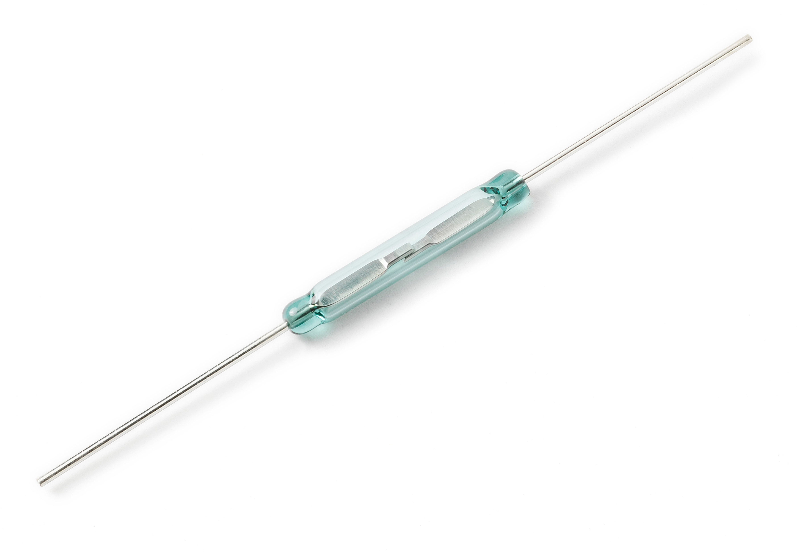
Motor Drive Power tool (BLDC example)
1
2
3
5
6
4
1
2
3
Technology | Series
HC SMD Fuse (24V up to 72V) | 1206SFH 456/463 series
VHC SMD Fuse (70V) | 881 Series
DC Cartridge Fuse | 688 Series
Technology | Series
SMD Thermal Fuse | HCRTP mini
Technology | Series
TVS Diode | SMAJ, SMBJ
6
4
5
Speed measurement
Technology | Series
I2C Line | ESD Protection
suction control
Technology | Series
Hall Effect Sensor | 55100
Technology | Series
Reed switch | MDSR-10
Contamination and wear-out resistant switching and controls => magnetic swtiching

Slide 28
AC Motor Protection
Fuse Selection
General considerations
Voltage rating
Interrupting rating
Re-rating for ambient temperature
Steady state analysis
Cycling analysis
Transient analysis
Transient overloads are typically high current, short duration events.
Motor start-up, light bulbs, etc.
MOV Selection
AC Motor protection is the surge withstand capability of the motor itself Paragraph 2036.4 of NEMA motor generator standard MG-1 define a unit value of surge as:0.816xV L-L for transient rise time of 0.1~0.2us,twice the unit value of surge capability is required on stator windings.When rise times reach 1.2us or greater,4.5 times the unit value is stipulated.In the case of external transients such as lightning,this would equate to a surge voltage capability.Since lightning surge can exceed these values, a suppression element would be required to protect the stator windings.

Slide 29

MOV energy for 8/20 surge and AC follow on
For the MOV, normally we calculate its go-through energy to confirm if the MOV rating is sufficient or not.
For Example; the total current energy through MOV V20E130P is 3kA 8/20 plus the 43A half cycle AC current. So the total energy is
Energy=K*Vc*Ipp*t
0.637 x 250 x 3000 x 20x10⁻⁶ + 0.637 x 250 x 43 x 0.01 =9.56+68.48=78.04J. ( K =0.637 for sine wave )
This value is less than V20E130P 100J datasheet specification. You also can use two V20E130P parallel connect for more surge buffer.

Slide 30
AC Motor Control
Motor
Tachometer Signal
∿
Motor Speed Control Circuit
240VAC
M
Opto-Isolated Triac
Vline
Res
C
High Power Anti-Parallel SCR Circuit
Current Rating = 1.4 x SCR Current Rating
(e.g. 70A SCR → 98A Current Rating)
Triac control

Slide 31
DC Motor Drive Circuit
Back EMF Protection
MOSFET gate Protection

Slide 32
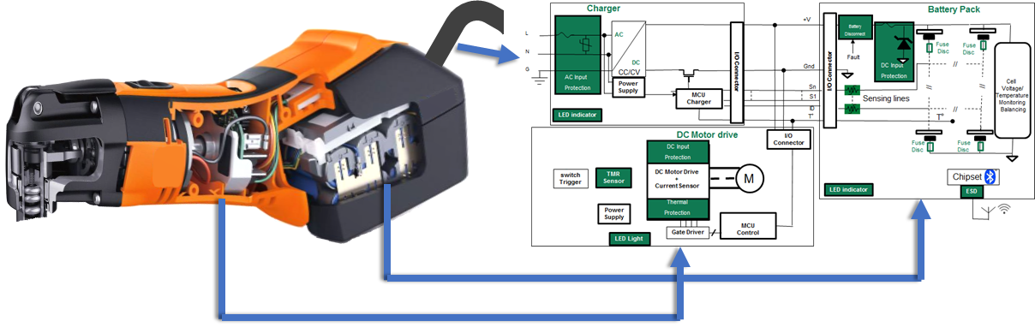
Overall Littelfuse Power tools product overview summary

Slide 33
Littelfuse’s system level approach is to help OEM’s make equipment safer and more reliable
Functional block | Circuit type | Function | Littelfuse Product Series
Charger or AC Power | Power Supply AC | Lightning Surge, induction spikes protection | Varistor (MOV) | TMOV, UltraMOV,
 |  | Power Fault/Short Circuit | Cartridge Fuse | 835, 215 , TR5 Series
 | LED indicators | ESD protection | Varistor (MOV) | MLV Series
 | DC output Protection | Battery Disconnect | On Demand Disconnect | Breaker
 | Contamination resistant interlock | Battery Pack locking detection | Reed Switch
Battery | DC input Protection | Battery Pack Over current protection | Blade Fuse or SMD Fuse | Midi Fuse/1206SFH/ 881 Series (SMD)
 |  | Over Voltage protection | TVS diode | 600W,1500,3000W Series
 | Contamination resistant interlock | Battery Pack locking detection
 | Cell/Pack Protection | Over current for multi-strings configuration | Strap PTC | VL,VT Series
 |  | Over temperature indication | PTC, NTC | PPTC
 |  | Large cell over temperature indication | zPTC | R&D program
 | DC output Protection | Sensing /Balancing lines protection | PTC or Fuse | nanoSMDC016/48 or nanoSMDC010F ,,466,440 438 Series
 | LED indicators | ESD protection | SPA,MLV | 0201,0402,0603 Series
 | Sensors | Battery Pack locking detection | Reed Switch
Main Unit | Motor | MOSFET Over temperature Protection | Thermal Fuse | HCRTP mini
 |  | Motor Over temperature detection | zPTC | R&D program
 |  | Speed measurement | Hall Sensor + Magnet
 |  | MOSFET EOS Protection | SPA | SD,SM series,SMF series
User Interface | Activation Triggers | ON/OFF/Gradual | Hall sensor | TMR sensor*R&D program
 | Displays & Indicators | ESD and surge protection | ESD protector | MLV Series
 | Wireless communication | ESD and surge protection | ESD protector | TVS Diode

Slide 34
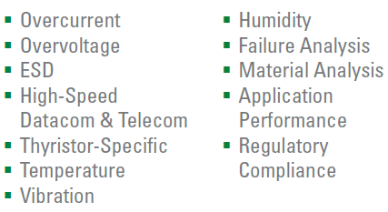
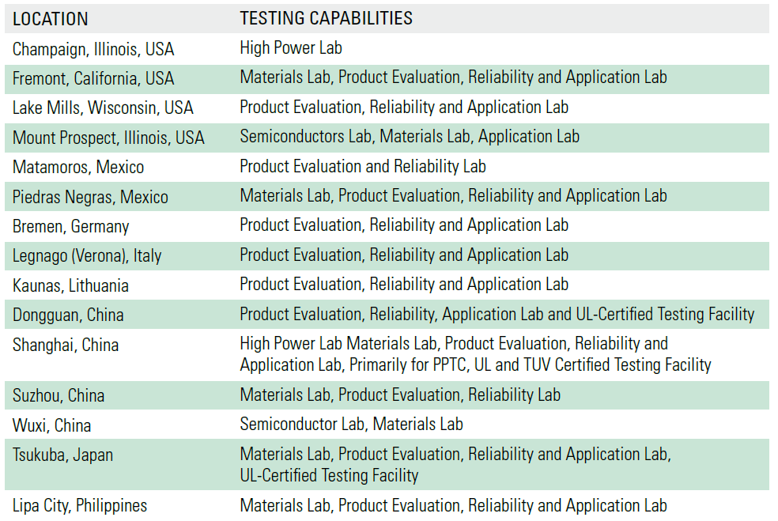

Testing Capabilities
http://www.littelfuse.com/~/media/files/littelfuse/technical-resources/documents/capabilities-brochures/littelfuse_global_labs_brochure.pdf
http://www.littelfuse.com/about-us/business-overview-video.aspx

Slide 35

Thank you!

Slide 36


