Slide 1
Quick Charging &
Qi Certification
Version 1.0 / 06.29.18 / Leon Lin
Notes:
fffffffffffff

Slide 2
Agenda
Qualcomm Quick Charging
Qi Certification
Notes:
吱吱吱吱吱吱吱吱吱吱吱吱吱吱吱

Slide 3

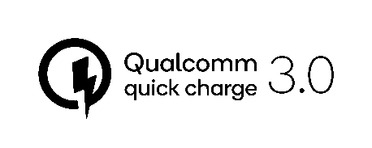
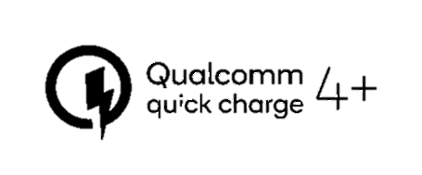



  QC advancements
MORE
TO
COME
2015
2016
2017
future
UL and the UL logo are trademarks of UL LLC © 2017. Proprietary & Confidential.

Slide 4
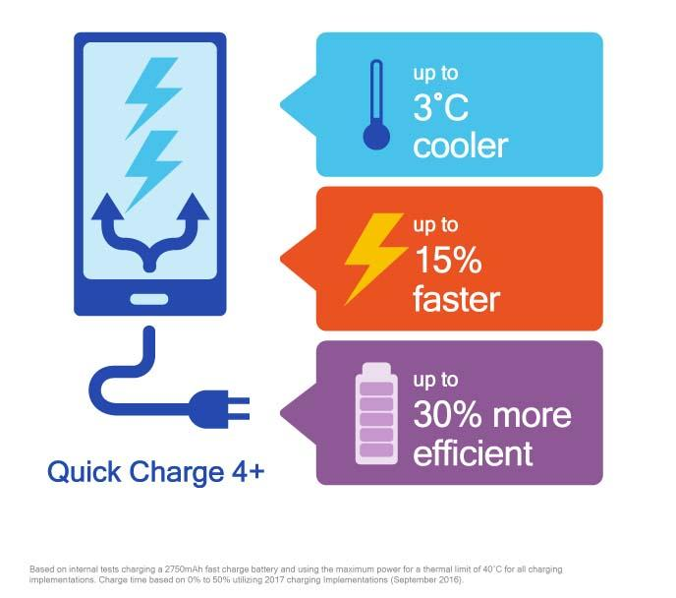
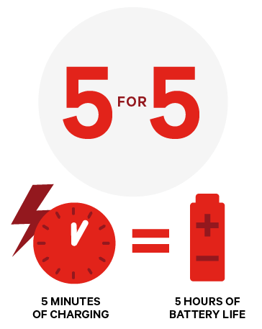
  QC4/4+ Introduction
  QC4 bases on USB Power Delivery (USB PD) Technology.
  QC4 can decrease the amount of time you spend tethered to an outlet giving your device 5 for 5 — that’s 5 hours of battery life from 5 minutes of charging.
  QC4+ is the upgrade version of QC4 that backward compatible to Quick Charge 3.0 and 2.0. QC4+ also includes, Dual Charge, Battery Saver and thermal balancing.
UL and the UL logo are trademarks of UL LLC © 2017. Proprietary & Confidential.
Notes:
1. Old news from Qualcomm website
- QC4 allows a device to be charged from empty to 50 percent in just 15 minutes while maintaining the plug-and-play ease of use of USB Type-C connectors.
·双路充电（Dual Charge）：双路充电的能力得到进一步提升，可分散充电电流，实现更少发热并缩短充电时间；
·智能热平衡：进一步增强双路充电，旨在自动通过温度最低的线路充电，避开发热点以优化充电；
·更先进的安全功能：在Quick Charge 4已包含严密内置安全协议的基础上，Quick Charge 4+更进一步，可同时监控终端外壳和连接器温度水平，该额外保护层有助于防范过热、短路或损害Type-C连接器。

Slide 5
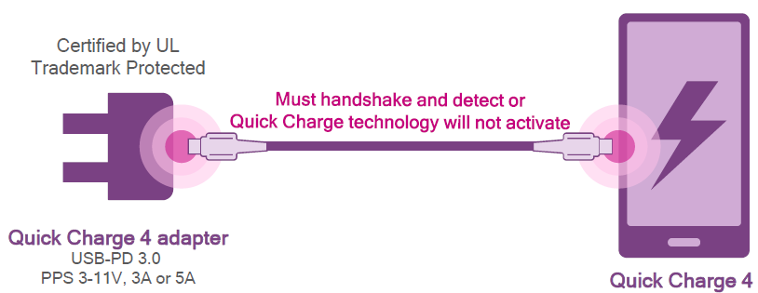
  How does Quick Charge 4 work ?
  Connect Smartphone and Charger via USB Type C
  Smartphone detects a QC4 Charger
  Smartphone requests a voltage from Charger
  Charger adjusts voltage dynamically based on INOV algorithm from Smartphone
UL and the UL logo are trademarks of UL LLC © 2017. Proprietary & Confidential.

Slide 6
  Process related to Qualcomm
  Signed mutual NDA (and IP for Chipset) with Qualcomm
  Obtain documents from Qualcomm (http://brand.qualcomm.com)
  Submit the Application to UL for certification and provide drawings/photos of the accessory and packaging to Qualcomm to review
  Considered IOP (Interoperability) test
  Approved products will be listed on the Qualcomm website
  Qualcomm contact window: Josh Warner (joshuaw@qti.qualcomm.com)
UL and the UL logo are trademarks of UL LLC © 2017. Proprietary & Confidential.

Slide 7
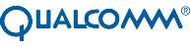


How long does it take?
1~2 Weeks
NDA
1 Week
Open Project
UL can provide QC2.0/3.0 and QC4+ service
2 Weeks Testing
IOP
1 Week Report/ Certificate
2 Weeks Label / Web
UL and the UL logo are trademarks of UL LLC © 2017. Proprietary & Confidential.

Slide 8
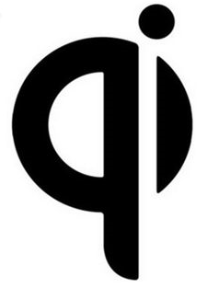



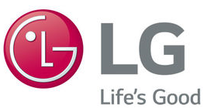


Qi certification
Wireless Power Consortium (WPC) created and maintains Qi (pronounced “chee”), the global standard for compatible wireless charging
Some members of WPC

Slide 9
Qi certification
The latest Qi specification: Version 1.2.4
UL Japan is accredited by WPC to conduct Qi Compliance Testing for Baseline Power Profile (BPP) up to 5 W and Extended Power Profile (EPP) > 5 W and up to 15 W.
UL Dongguan, China: To be accredited for BPP and EPP.

Slide 10
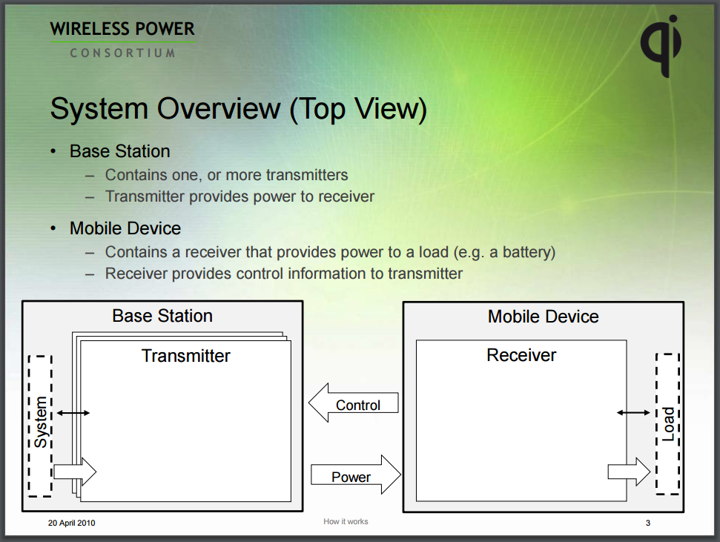
Qi certification
UL and the UL logo are trademarks of UL LLC © 2017. Proprietary & Confidential.

Slide 11
Qi certification
Before starting Certification - Compliance Testing in UL, the customer has to be the member of WPC and register test sample in the member area of WPC website
5 test samples are needed and not returned to customer according to the policy of WPC
Interoperability Testing in TTA or Eurofins
Lead time is about 4 weeks
UL and the UL logo are trademarks of UL LLC © 2017. Proprietary & Confidential.

Slide 12
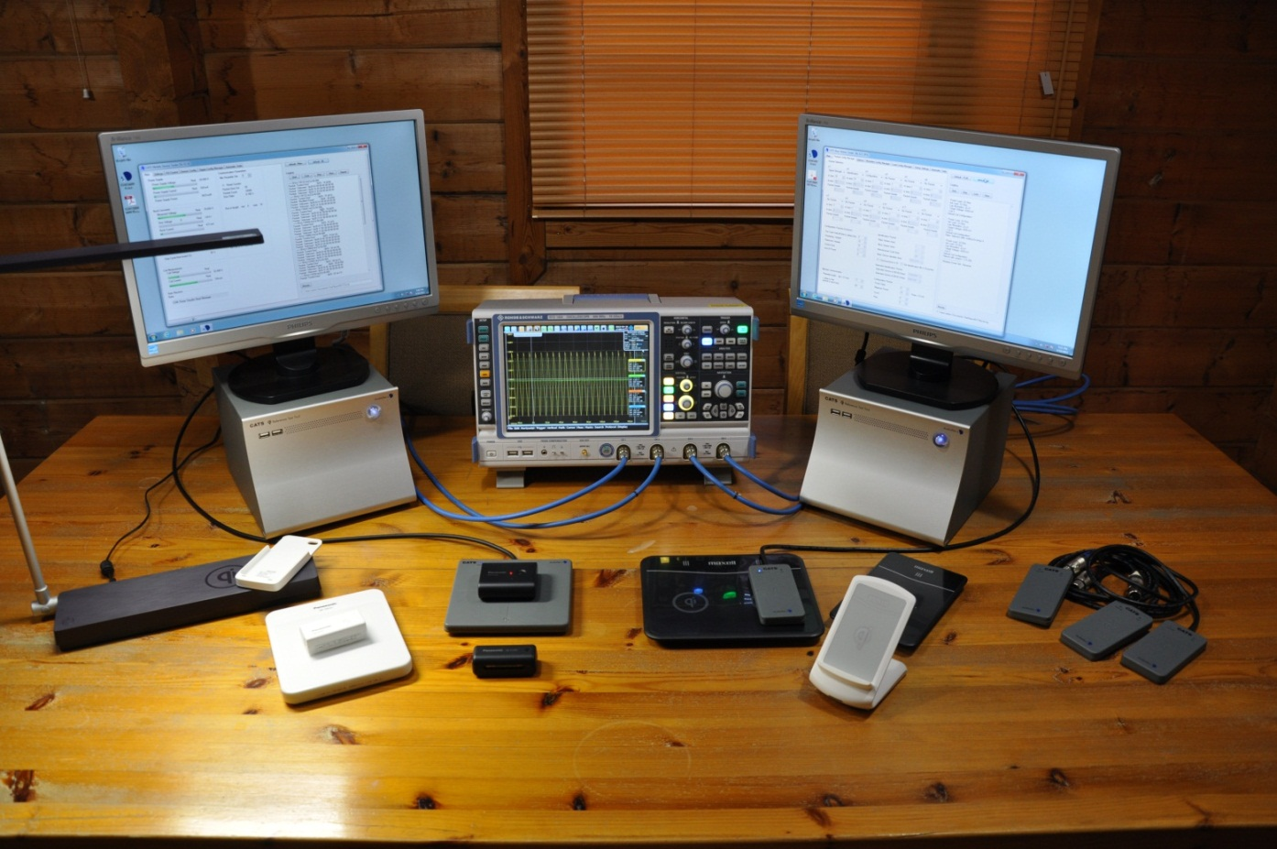
Qi certification
Compliance Testing
  CATS I MDT (with TPT)
  EUT
  CATS I BST (with TPR)
  Test Power Transmitter, TPT
  Test Power Receiver, TPR
UL and the UL logo are trademarks of UL LLC © 2017. Proprietary & Confidential.

Slide 13
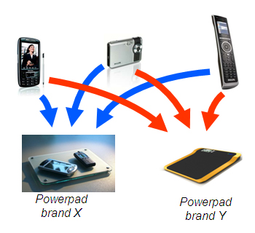
Qi certification
Interoperability Testing
UL and the UL logo are trademarks of UL LLC © 2017. Proprietary & Confidential.

Slide 14
Qi certification
Base Station under Test shall be tested against all certified Mobile Devices
Mobile Device under Test shall be tested against all certified Base Stations
Test fails if function work cannot work normally within 3 times
UL and the UL logo are trademarks of UL LLC © 2017. Proprietary & Confidential.

Slide 15
Qi certification
Join the WPC as a member
Safety and good user experience
UL Certification:
Product safety
Compliance testing and interoperability testing
Qi Certification:
Construction review, safety testing and factory inspection
Market access
Each certification is independent. Both certifications are important!

Slide 16
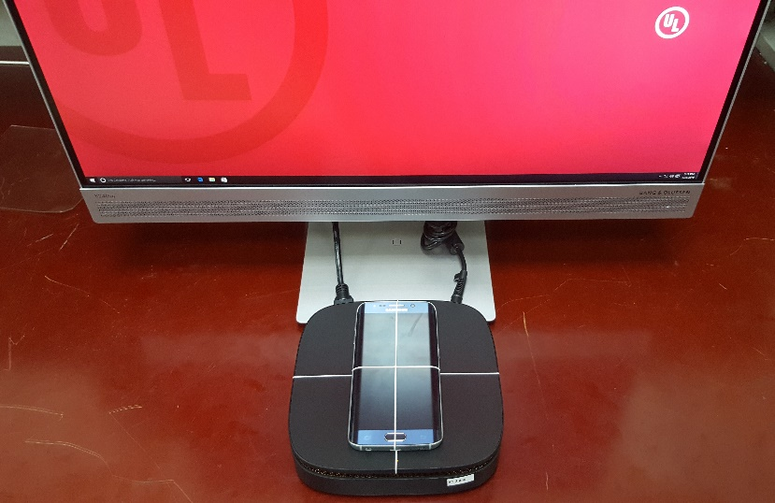
Worldwide regulations
Wireless (Power Transfer) & EMC
FCC, ISED & CE
RF Exposure (User Safety)
FCC, ISED & CE
1
2
ALL CAN BE TESTED IN UL SSL
Product Safety
GMA
3
UL and the UL logo are trademarks of UL LLC © 2017. Proprietary & Confidential.

Slide 17
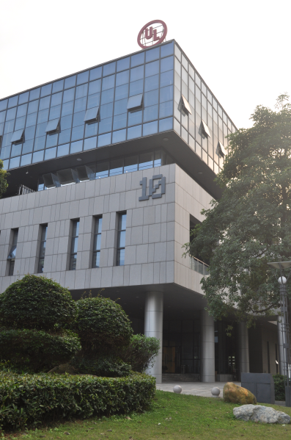
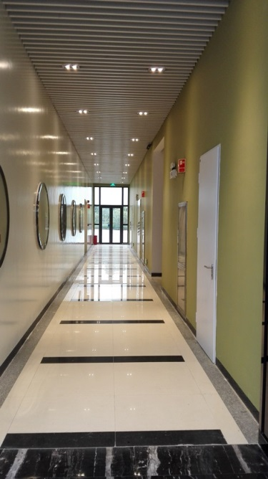
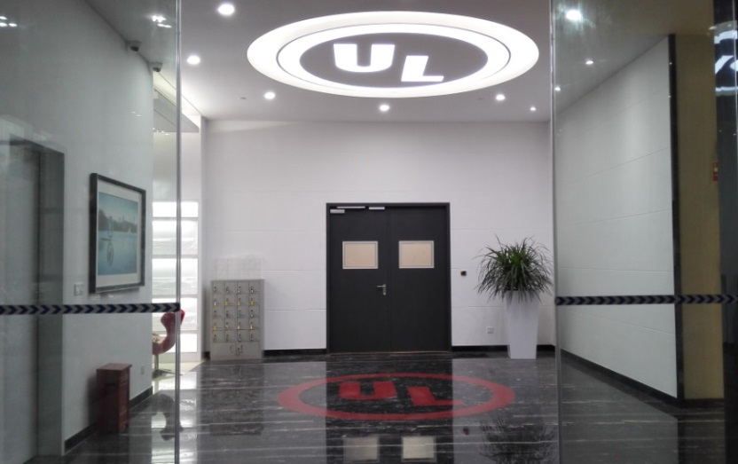
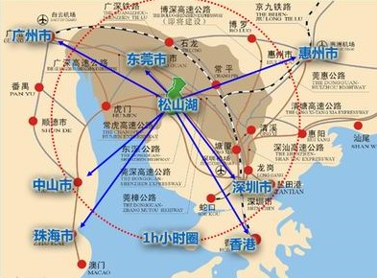
UL SSL Office(Lab)

Slide 18
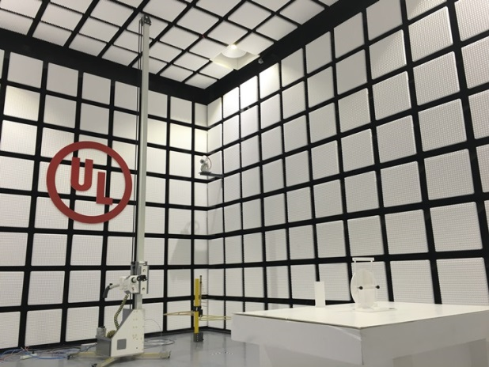
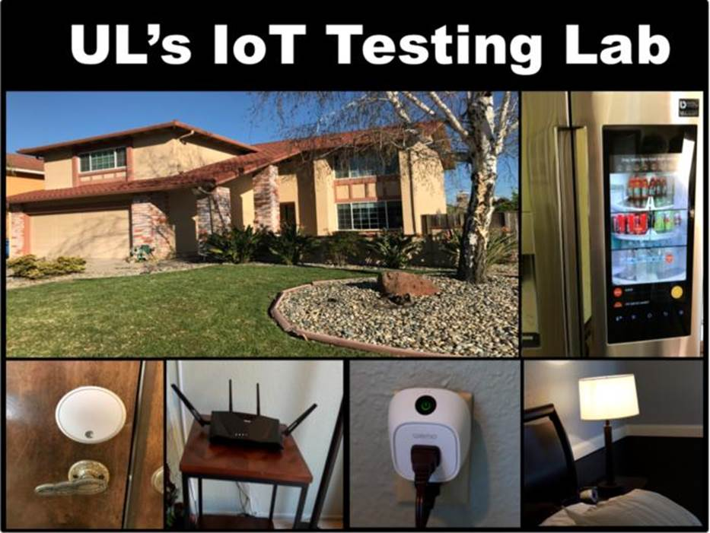
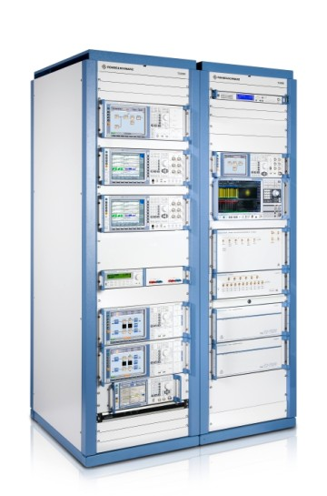
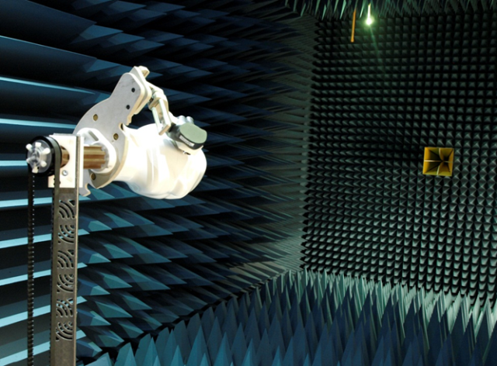
UL _ EMC/RF/Telecom --- IOT

Slide 19










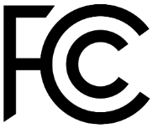
支付/网络安全
互通性 / 可用性
协议符合性
行业联盟认证
法规要求

Slide 20


在松山湖物联网实验室, 我们可以提供以下服务…
协议符合性
互通性
网络安全
法规认证
行业联盟认证

Slide 21
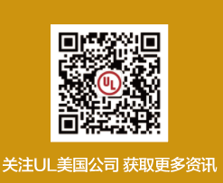
Thank you
Find us on…

