Slide 1
Type-C, USB PD 3.0 PPS, QC4+
Total Solution
Eilian Liu
Product Marketing
June 29, 2018
Leadtrend Confidential for Big-Bit Only

Slide 2

LD6610 Certification
USB IF: PD2.0/PD3.0/PPS
Qualcomm: Quick Charge C4.0

Slide 3
USB Type-C™ and USB PD Testing
USB PD Compliance Test Equipment
QuadraMAX (Power Brick PPS )
http://www.usb.org/developers/estoreinfo/
Communication Engine MOI
MQP PDT
http://www.mqp.com/pd.htm
Granite River Labs - GRL-USB-PD Oscilloscope based and USB-PD-C1 USB Type-C Test Controller Compliance Solution
http://graniteriverlabs.com/usb-pd
Granite River Labs - GRL-USB-PD-C2 USB Type-C Power Delivery Tester
http://graniteriverlabs.com/usb-pd-c2/
Teledyne LeCroy - Voyager M310P Protocol Analyzer / Exerciser / Compliance Test Platform
http://teledynelecroy.com/protocolanalyzer/protocoloverview.aspx?seriesid=556&capid=103&mid=511
Deterministic MOI
Ellisys USB Explorer™ 350 Protocol Analyzer, Generator, and Compliance Test System
http://ellisys.com/products/usbex350/index.php

Slide 4
USB Power Delivery PPS Certification Flow
1. PPS Specification Document:
- USB_PD_R3_0 V1.1 20180207
- USB PD R3 0 V1 1 ECN PPS Current Requirements above Nominal Prog Voltage 20170918
- USB PD R3.0 V1.1 ECN APDO Min Voltage
- USB PD R3.0 V1.1 ECN PPS Status measurements
- USB PD R3.0 V1.1 iPpsCLTransient clarification 20180207
http://www.usb.org/developers/docs/
2. PPS Test Document: USB-C_Source_Power_Test_Specification_2018_01_03 (Revision 0.74)
http://www.usb.org/developers/compliance/usbcpd_testing/
3. PPS Test Equipment: QuadraMAX
http://www.usb.org/developers/estoreinfo

Slide 5
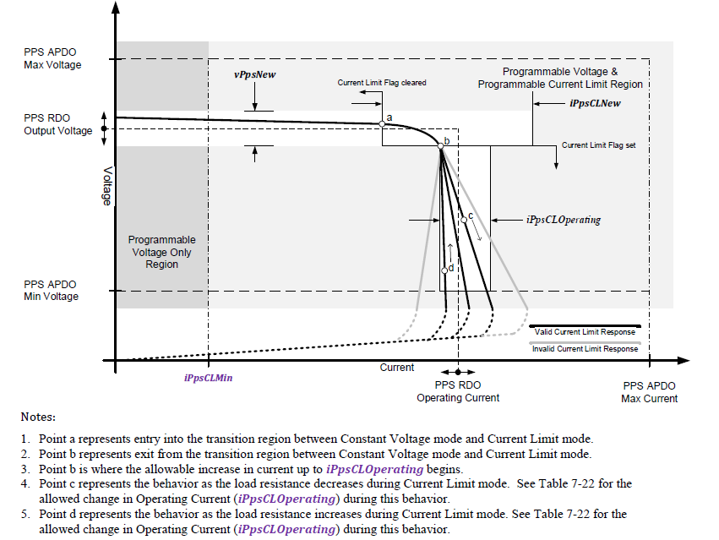
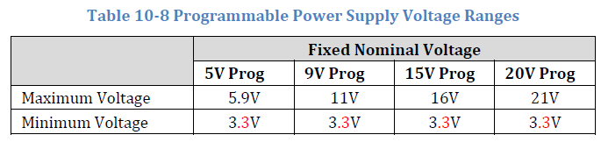
PPS Programmable Voltage and Current Limit

Slide 6
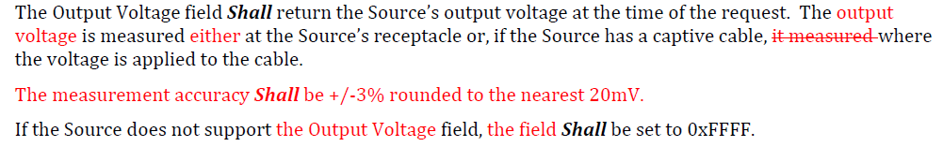
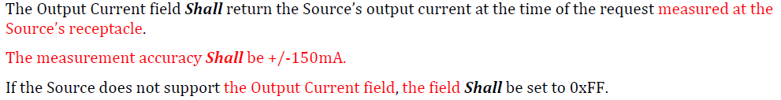
PPS Voltage and Current Accuacy

Slide 7
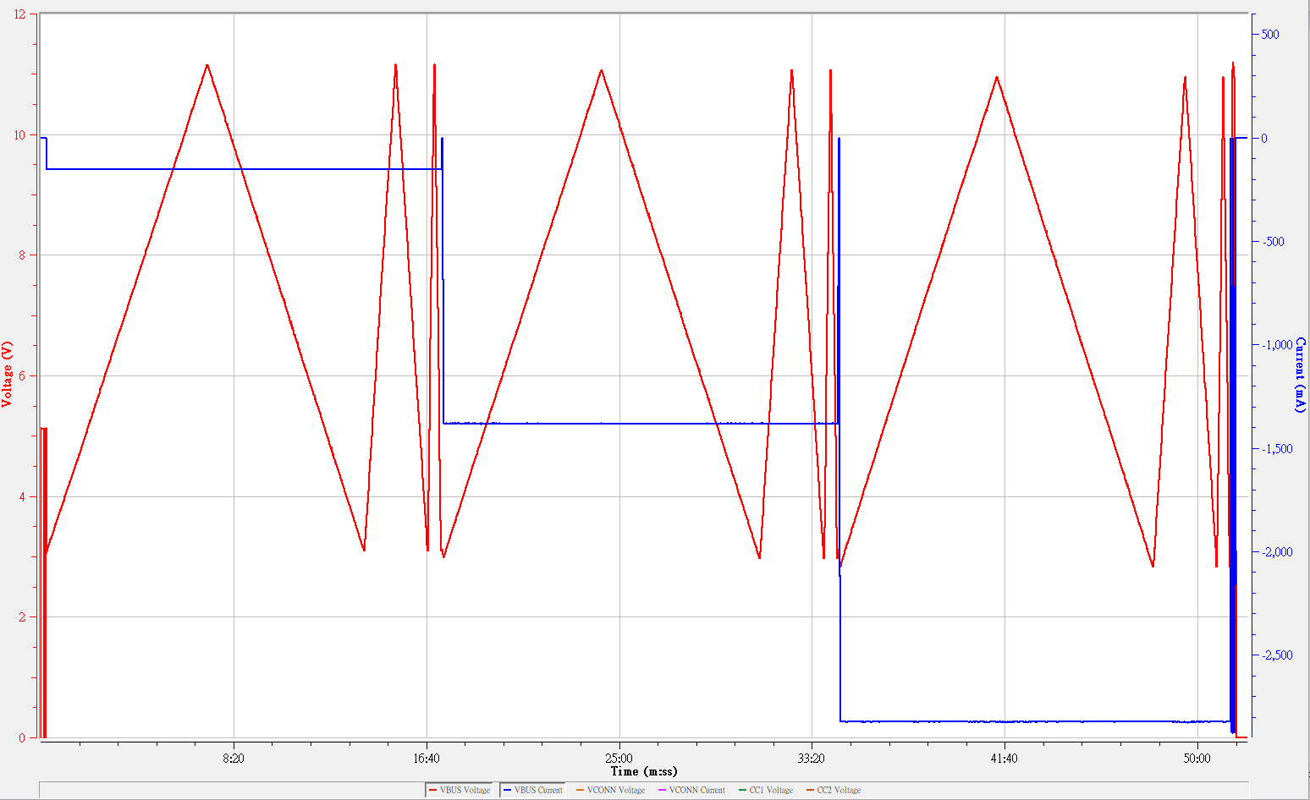
Output Voltage Transition
PPS Mode ( SPT. 6 PPS Voltage Step Test ):
A. Purpose:
The PPS Step Test verifies that when a source port makes a contract using an APDO its output follows the monotonicity and tolerance requirements from USB PD spec section 7.1.4.3.
This test is required for all USB PD ports that advertise APDO capabilities.
This is a single port test at this time.
This is a USB PD 3.0 test only
C. Step Size Conditions:
20mV
100mV
500mV
D. Operating Current Conditions:
1 A
APDO Maximum Current / 2 + 500 mA
APDO Maximum Current
1.4A
Workshop 107 TID025
VST: PASS
2.8A

Slide 8
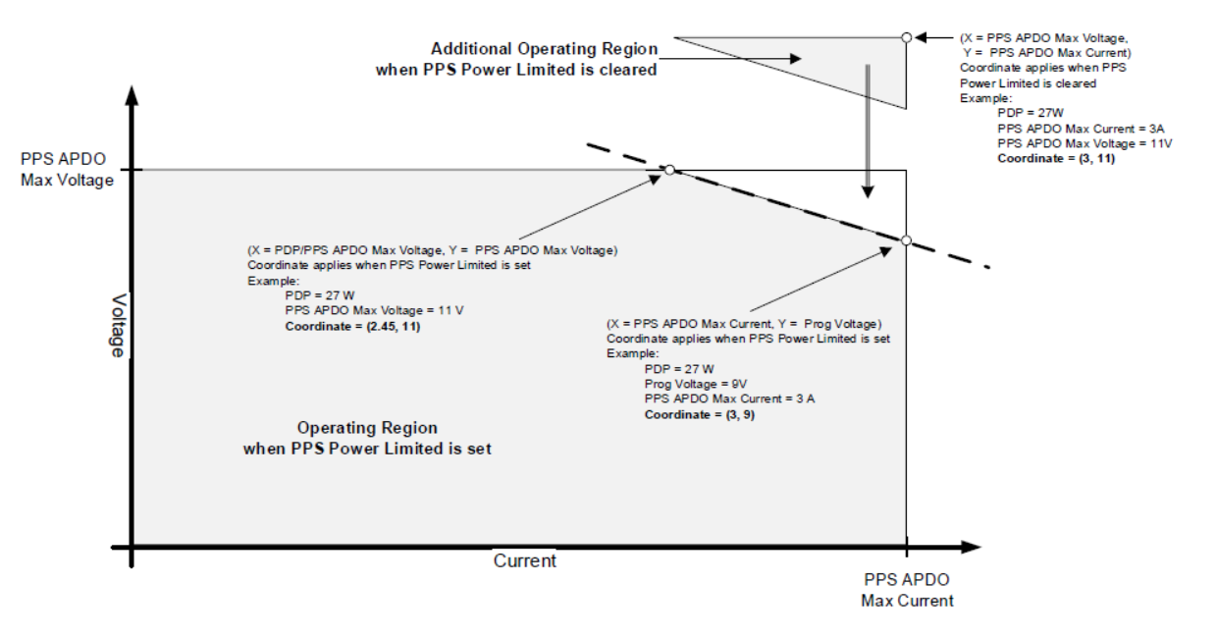
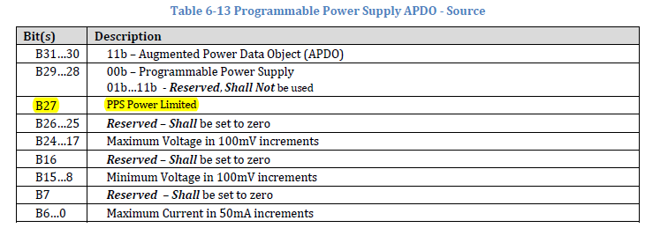
PPS Constant Power Mode

Slide 9
LD6610 Solution Example: Type-C Power Adapter / Mobile Charger
LD576X Value
LD852X Value
LD661X Value
- X-Cap Discharge, No Load <30mW
- OCP/OPP/OSCP/CS_OTP Protections
- VCC Ratting
LD5763 70V
LD5765 80V
- Adaptive Loop Gain for Loop Stability
- Adaptive Current Limit to meet LPS
- LD8523 (MP): Vout 3V~11V
DET pin rating 85V
- LD8525 (MP): Vout 5V~20V
DET pin rating 150V
- LD8526(ES): Vout 3V to 21V,
DET pin rating 200V
- Ultra low Green Mode current
< 250uA
- Provides Type-C solution with Power Delivery 3.0 (PD 3.0) with programmable power supply support and Quick Charge 4.0 (QC 4.0)
- Min. V&I resolution 10mV/25mA for PPS
- Programmable OCP, OVP, UVP, OTP

Slide 10
Leadtrend
SSR PWM Controller
LD5763
Features:
UHV 750V.
X-Cap Discharge, No Load <30mW
OCP/OPP/OSCP/CS_OTP Protections
VCC Ratting around
LD5763 = 70V
Adaptive Loop Gain for Loop Stability
Adaptive Current Limit to meet LPS
+300mA/-800mA Driving Capability
Built- in Two Level Frequency on HV pin (Option)
PKG Tape:
SOP-8 and SOP-7

Slide 11
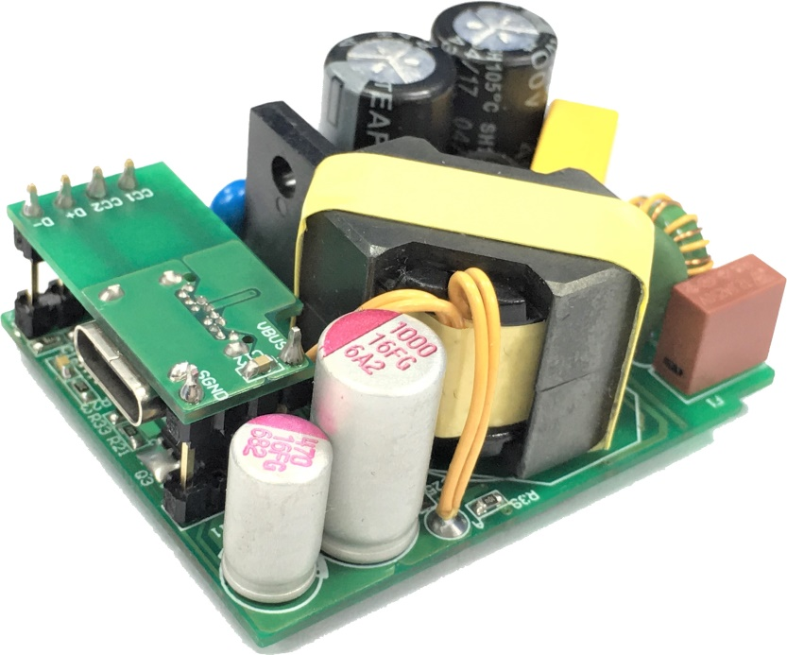
LD6610 PD3.0 PPS Reference Circuit
DBPDP1704B
Size 48mm(L) x 36 (W)mm x 18mm(H)

Slide 12
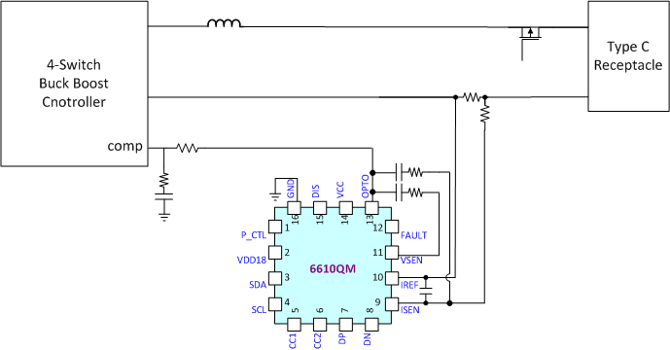
LD6610 Solution Example: Car Charger，Multi- Port Wall Adapter
Car Charger
Wall Adapter 1A+1C
NB compatible testing for PD accessories
Apple Mac Air, Macbook Pro, iPhone X/8/Plus
Huawei
Lenovo
HP
Dell
NINTENDO SWITCH

Slide 13
Accelerate Time-to-Market With Reference Designs
Application | PWM | SR | PD Controller | QC2.0 QC3.0 | QC4.0² | 5V Only | PD3.0 | PPS | Output Voltage Level
15W 5V Only Travel Charger | LD5512 (PSR) | LD8923 (MOSFET) | LD8200S or LD3103⁶ |  |  | ü |  |  | 5V
 | LD5523 (PSR) | LD8923 (MOSFET) | LD8200S or LD3103⁶ |  |  | ü |  |  | 5V
27W QC4.0 Travel Charger | LD5763⁵ | LD8523 | LD6610GQMW | ü | ü |  | ü | ü | 5V, 9V, 3.3V- 5.9V³, 3.3V- 11V³, 12V¹
Notebook Adapter 45W | LD5763 | LD8525 | LD6610GF |  |  |  | ü |  | 5V, 9V, 15V, 20V
Notebook Adapter 61W | LD5763 | LD8525 | LD6610GF |  |  |  | ü |  | 5V, 9V, 15V, 20V
Dual Port Wall Adapter 45W⁴ | LD5765⁵ | LD8526 (ES) | LD6610GQMW | ü | ü |  | ü | ü | 5V, 9V, 12V, 15V, 20V 3.3V- 5.9V³, 3.3V- 11V³ 3.3V- 16V³
1. 12 V is required for Quick Charge 2 and Quick Charge 3 2. Quick Charge 4 compatible the latest USB PD programmable power supply rules 3. Programmable power supply (PPS), four APDOs a) 3.3V-5.9V, b) 3.3V-11V, c) 3.3V-16V, d) 3.3V-20V. Optional indicates a Host OEM decision 4. under development 5. Recommend LD5765 for 3.3V-16V or 3.3V-20V voltage level 6. LD3103 integrated PMOS load switching

Slide 14
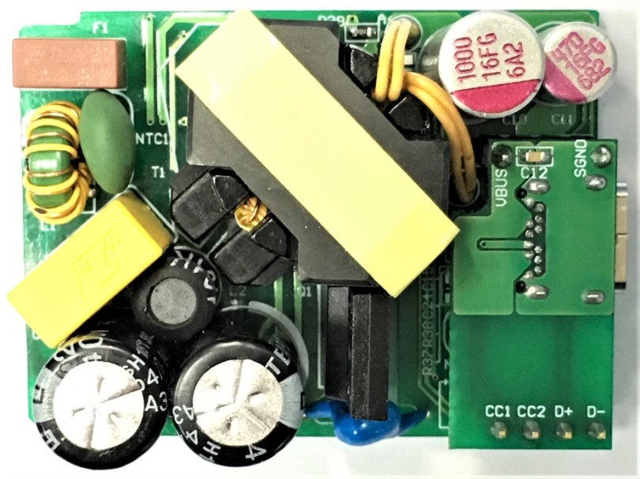
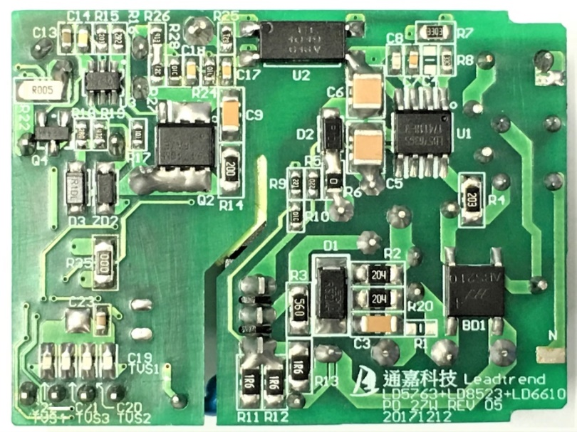
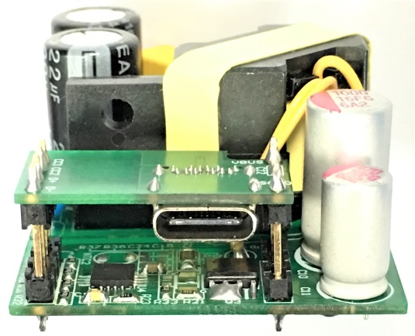
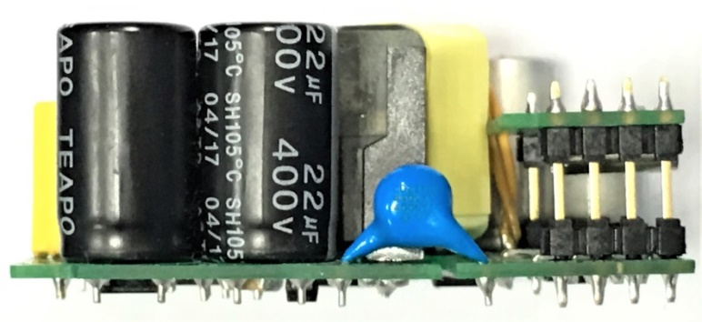
27W QC4.0 Travel Charger
12.2 W / inch³
Top View
Bottom View
36 mm
48 mm
LD5763
LD8523
21 mm
LD6610
Side View
Rear View

Slide 15
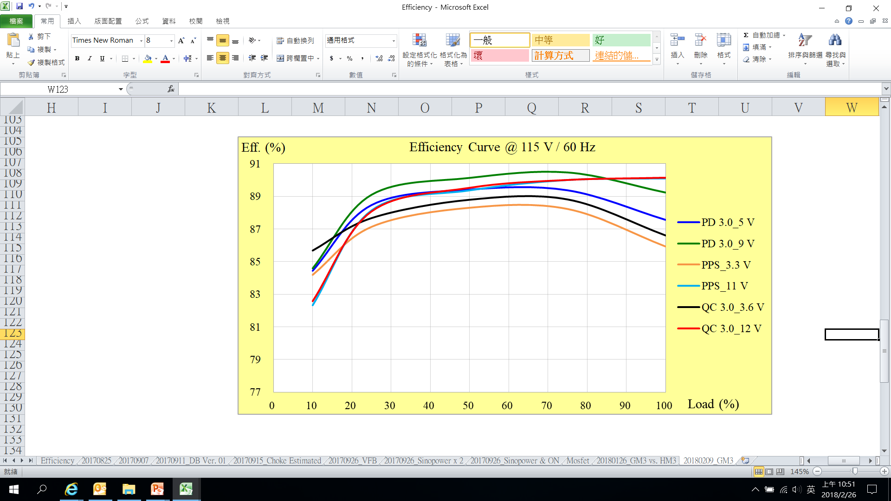
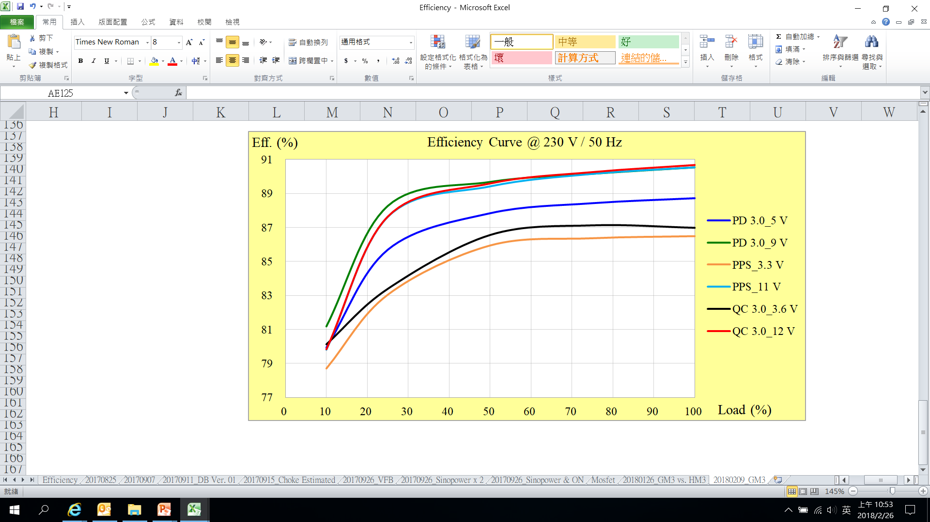
27W QC4.0 Travel Charger Efficiency
27W QC4.0 Travel Charger
Input Voltage | 115 V_{AC} / 60 Hz | 230 V_{AC} / 50 Hz
Output Current | 100 %, 75 %, 50 %, 25 %, 10 % of Full Load
Measured Point of Output Voltage | End of PCB
Duration of Burn-in | 30 Minutes
Requirement | CoC Tier 2

Slide 16
27W QC4.0 Travel Charger Efficiency ( Cont. )
V_{IN,AC} ( V / Hz ) | Mode | V_{BUS,SET} ( V ) | V_{BUS,PCB} ( V ) | I_{OUT} ( A ) | P_{BUS,PCB} ( W ) | P_{IN} ( W ) | η ( % ) | η_{AV,4-Points} ( % ) | Requirement ( % )
115 / 60 | PD 3.0 | 5 | 5.0809 | 2.9940 | 15.212 | 17.373 | 87.562 | 88.705 | > 81.84
 |  |  | 5.0860 | 2.2440 | 11.413 | 12.770 | 89.373
 |  |  | 5.0907 | 1.4960 | 7.616 | 8.517 | 89.417
 |  |  | 5.0951 | 0.7480 | 3.811 | 4.308 | 88.466
 |  |  | 5.0977 | 0.2960 | 1.509 | 1.787 | 84.439 | ─ | > 72.48
 |  | 9 | 9.1011 | 2.9940 | 27.249 | 30.535 | 89.238 | 89.684 | > 87.30
 |  |  | 9.1061 | 2.2440 | 20.434 | 22.607 | 90.388
 |  |  | 9.1097 | 1.4960 | 13.628 | 15.140 | 90.014
 |  |  | 9.1135 | 0.7480 | 6.817 | 7.651 | 89.098
 |  |  | 9.1160 | 0.2960 | 2.698 | 3.190 | 84.587 | ─ | > 77.30
 | PPS | 3.3 | 3.3067 | 2.9510 | 9.758 | 11.356 | 85.929 | 87.398 | > 78.93
 |  |  | 3.3170 | 2.2460 | 7.450 | 8.444 | 88.228
 |  |  | 3.3276 | 1.4980 | 4.985 | 5.645 | 88.304
 |  |  | 3.3385 | 0.7480 | 2.497 | 2.866 | 87.132
 |  |  | 3.3448 | 0.2960 | 0.990 | 1.176 | 84.189 | ─ | > 69.66
 |  | 11 | 11.1015 | 2.4110 | 26.766 | 29.706 | 90.102 | 89.405 | > 87.30
 |  |  | 11.1039 | 1.8410 | 20.442 | 22.712 | 90.007
 |  |  | 11.1072 | 1.2260 | 13.617 | 15.237 | 89.371
 |  |  | 11.1103 | 0.6130 | 6.811 | 7.727 | 88.140
 |  |  | 11.1120 | 0.2510 | 2.789 | 3.388 | 82.323 | ─ | > 77.30
 | QC 3.0 | 3.6 | 3.5999 | 3.0000 | 10.800 | 12.470 | 86.605 | 87.971 | > 79.56
 |  |  | 3.6078 | 2.2500 | 8.118 | 9.140 | 88.813
 |  |  | 3.6151 | 1.5000 | 5.423 | 6.107 | 88.794
 |  |  | 3.6225 | 0.7500 | 2.717 | 3.099 | 87.669
 |  |  | 3.6271 | 0.3000 | 1.088 | 1.270 | 85.680 | ─ | > 70.27
 |  | 12 | 12.0240 | 2.2460 | 27.006 | 29.958 | 90.146 | 89.439 | > 87.30
 |  |  | 12.0270 | 1.6870 | 20.290 | 22.542 | 90.008
 |  |  | 12.0300 | 1.1250 | 13.534 | 15.117 | 89.527
 |  |  | 12.0330 | 0.5620 | 6.763 | 7.678 | 88.077
 |  |  | 12.0340 | 0.2250 | 2.708 | 3.279 | 82.575 | ─ | > 77.30

Slide 17
27W QC4.0 Travel Charger Efficiency ( Cont. )
V_{IN,AC} ( V / Hz ) | Mode | V_{BUS,SET} ( V ) | V_{BUS,PCB} ( V ) | I_{OUT} ( A ) | P_{BUS,PCB} ( W ) | P_{IN} ( W ) | η ( % ) | η_{AV,4-Points} ( % ) | Requirement ( % )
230 / 50 | PD 3.0 | 5 | 5.0812 | 2.9940 | 15.213 | 17.147 | 88.722 | 87.670 | > 81.84
 |  |  | 5.0867 | 2.2440 | 11.415 | 12.908 | 88.430
 |  |  | 5.0912 | 1.4960 | 7.616 | 8.671 | 87.838
 |  |  | 5.0957 | 0.7480 | 3.812 | 4.448 | 85.692
 |  |  | 5.0985 | 0.2960 | 1.509 | 1.888 | 79.934 | ─ | > 72.48
 |  | 9 | 9.1013 | 2.9940 | 27.249 | 30.097 | 90.538 | 89.662 | > 87.30
 |  |  | 9.1060 | 2.2440 | 20.434 | 22.664 | 90.160
 |  |  | 9.1097 | 1.4960 | 13.628 | 15.196 | 89.682
 |  |  | 9.1135 | 0.7480 | 6.817 | 7.723 | 88.267
 |  |  | 9.1158 | 0.2960 | 2.698 | 3.324 | 81.176 | ─ | > 77.30
 | PPS | 3.3 | 3.3063 | 2.9510 | 9.757 | 11.281 | 86.490 | 85.460 | > 78.93
 |  |  | 3.3170 | 2.2460 | 7.450 | 8.626 | 86.367
 |  |  | 3.3275 | 1.4980 | 4.985 | 5.800 | 85.941
 |  |  | 3.3384 | 0.7480 | 2.497 | 3.007 | 83.044
 |  |  | 3.3448 | 0.2960 | 0.990 | 1.258 | 78.701 | ─ | > 69.66
 |  | 11 | 11.1009 | 2.4110 | 26.764 | 29.561 | 90.539 | 89.435 | > 87.30
 |  |  | 11.1046 | 1.8410 | 20.444 | 22.676 | 90.155
 |  |  | 11.1076 | 1.2260 | 13.618 | 15.229 | 89.421
 |  |  | 11.1111 | 0.6130 | 6.811 | 7.773 | 87.625
 |  |  | 11.1125 | 0.2510 | 2.789 | 3.495 | 79.807 | ─ | > 77.30
 | QC 3.0 | 3.6 | 3.5999 | 3.0000 | 10.800 | 12.416 | 86.982 | 86.015 | > 79.56
 |  |  | 3.6078 | 2.2500 | 8.118 | 9.317 | 87.126
 |  |  | 3.6153 | 1.5000 | 5.423 | 6.265 | 86.559
 |  |  | 3.6225 | 0.7500 | 2.717 | 3.258 | 83.391
 |  |  | 3.6270 | 0.3000 | 1.088 | 1.358 | 80.125 | ─ | > 70.27
 |  | 12 | 12.0240 | 2.2460 | 27.006 | 29.782 | 90.679 | 89.543 | > 87.30
 |  |  | 12.0270 | 1.6870 | 20.290 | 22.479 | 90.260
 |  |  | 12.0300 | 1.1250 | 13.534 | 15.106 | 89.592
 |  |  | 12.0330 | 0.5620 | 6.763 | 7.716 | 87.643
 |  |  | 12.0350 | 0.2250 | 2.708 | 3.392 | 79.831 | ─ | > 77.30

Slide 18
27W QC4 No Load Power Consumption
Input Voltage | 115 V_{AC} / 60 Hz | 230 V_{AC} / 50 Hz
Output Current | 0 A ( Disconnect USB Type-C Cable )
Requirement | CoC Tier 2
V_{IN,AC} ( V / Hz ) | P_{IN} ( mW ) | Requirement ( mW )
115 / 60 | 19 | < 75
230 / 50 | 22
No Load Standby Power Consumption is < 30 mW @ 230 V_{AC}

Slide 19
PD3.0 PPS / QC4 Certification and Testing Tools
Leadtrend communication Engine MOI: GRL C2, Ellisys, QuadraMax
DBPDP1704B - PD 3.0 / QC 4.0+ Test Kit
Wall adapter or Accessories
Power Meter
&
Eload
Type C Cable
DBPD1704B

Slide 20


