Slide 1
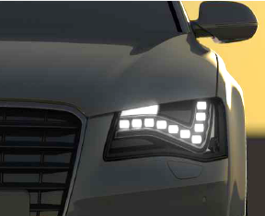
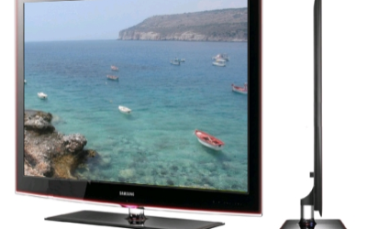
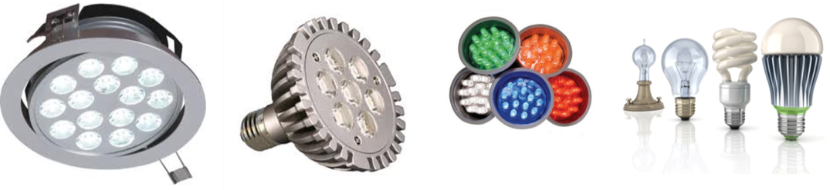
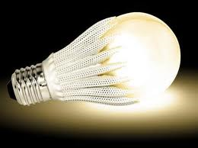

IMS Research
LED Lighting Market Overview

Slide 2
Outline
About IHS IMS Research
The Lighting Opportunity
Retail LED Lamp Market
Power in LED Lighting
Summary

Slide 3
About IHS IMS Research
Founded in the 1980s in the UK by former TI semiconductor executives.
Headquartered in Wellingborough, Northants but global company with offices in US, China, Korea and Japan.
Well over 100 analysts.
Covers many areas e.g. automotive, industrial, consumer etc.
Lighting and LEDs is one group with analysts in UK(3), Korea(3), Taiwan(1), China(1) and the US(1).
Produced higher quality and more detailed reports than some competitors.
Acquired by IHS in March 2012. Our LED group now has access to data from Displaybank and iSuppli.

Slide 4
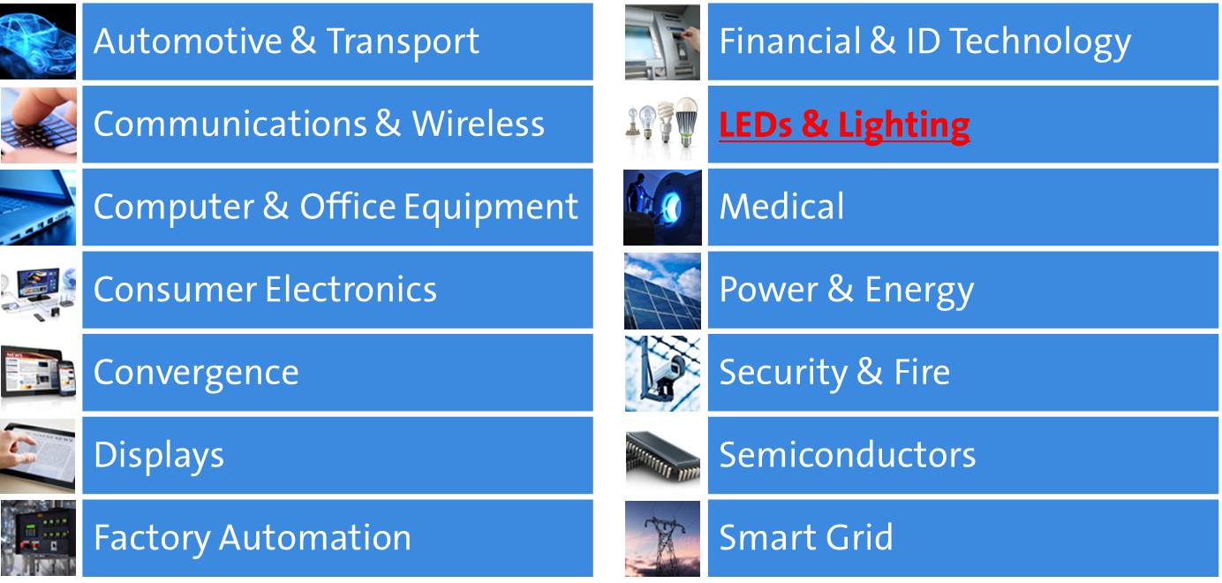
Major Groups

Slide 5
LED Reports
Quarterly LED Supply and Demand Report
  Quarterly look at MOCVD shipments, LED panel shipments, LED consumption, LED & sapphire pricing and LED capacity in 2” & 4” equivalents, actual wafers, die capacity, yielded die capacity and binned die capacity.
  Annual demand forecasts to 2016 for MOCVD & sapphire and LEDs by application & die size.
  Annual supply forecasts to 2016 by LED manufacturer in 2” & 4” equivalents, actual wafers, die capacity, yielded die capacity and binned die capacity.
Annual Lamps & Luminaire Report
  9 applications and 7 regions out to 2020, including installed base.
Monthly Global LED Lamp Price Tracker
  ~1000 lamps and 14 countries, 72 brands and 32 retail stores.
Annual Packaged LEDs Report
LED Manufacturer Profiles
  >100 companies
Annual LED Driver IC Report
Extensive Consulting:
  Supply Chain Market Sizing, Company Assessments, Due Diligence, etc.

Slide 6































Customers
Notes:
I just want to give you a quick overview of our group. Our Lighting and LEDs research group has 6 analysts based in UK, US, China and Taiwan, so we’re gathering data locally in each of those regions. Including Displaybank, our sister company, we have 9 LED-focused analysts.
Discuss reports.
We sell our LED reports to almost all of the leading LED companies.
We also sell to many other types including equipment companies and financial institutions.

Slide 7
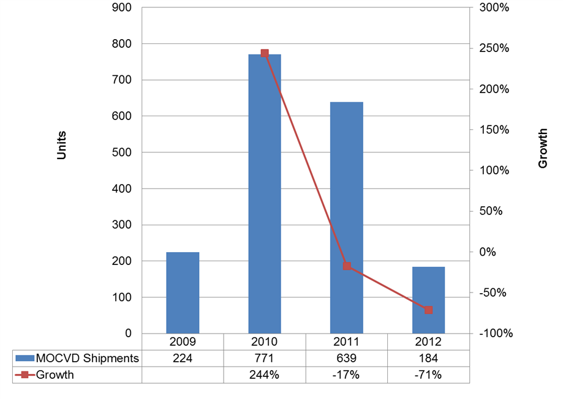
Merchant GaN MOCVD Market

Slide 8
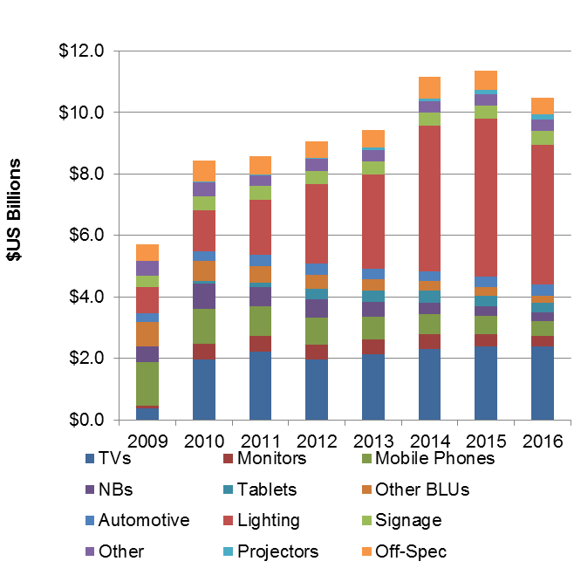
Total GaN LED Revenues by Application
The GaN LED market grew aggressively in 2010 due to economic recovery, LED TVs and notebooks, and other factors. It is a relatively flat market currently (from 2010 to 2013).
2014 is expected to be a strong growth year (forecast at 18% revenue growth) due primarily to lighting as LED lamps reach a more realistic price and 60W incandescent bulbs are banned in various countries including US and China.
Lighting is the biggest growth story, expected to rise from $1.8B in 2011 to $5.1B in 2015, overtaking TVs in 2012. Lighting is projected to reach 45% of the total GaN market in 2015.

Slide 9
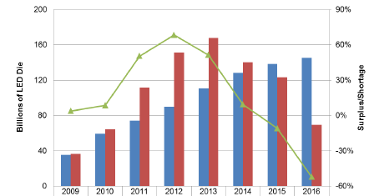
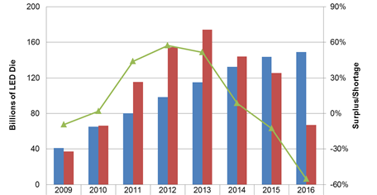
LED Supply/Demand
In 2011 there was a large excess of supply which remains in 2012 due to China subsidies still continuing in some areas, new entrants ramping up, and purchases made in advance of the coming demand in lighting. Outside of China and Taiwan, the merchant MOCVD market has almost completely collapsed.
This is the imaginary shortfall that would theoretically occur if no more machines were installed after 2012. This indicates clearly that rapid growth in demand from lighting along with retiring of older MOCVD tools will result in significant demand for new MOCVD tools to meet 2014-2016 demand.

Slide 10
Why LED Lighting?
More efficient than incandescent + Better colour quality than CFL = WIN (when the price is right…right means single digit..see later slide on lamp pricing)
Other advantages include no mercury or lead, instant-on, 40K hour lifetimes, more rugged, no cold starting issues, etc.

Slide 11
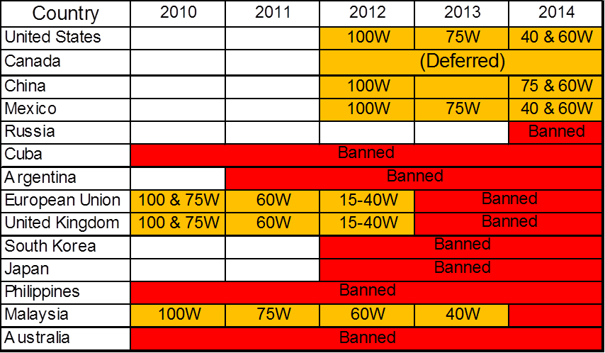
Incandescent Phase-out
Regional Banning/Phasing out of incandescent lamps is and will continue to have a huge impact on the lamp replacement market

Slide 12
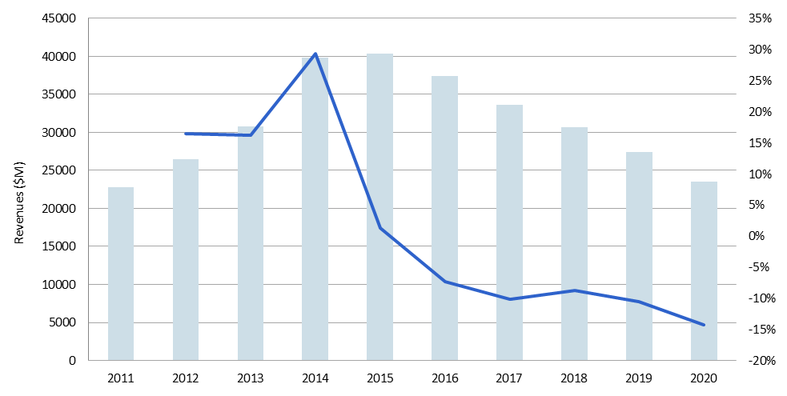
Global Lamp Market
World lamp market is forecast to grow with 15% CAGR through 2015.
  ~$23 billion in 2011 peaking at ~$41 billion in 2015.
  Projected to fall steadily to around $24 billion in 2020.
LED market will see largest change, growing from ~$4 billion in 2011 to ~$23 billion in 2015, before falling back to around ~$16 billion in 2020.

Slide 13
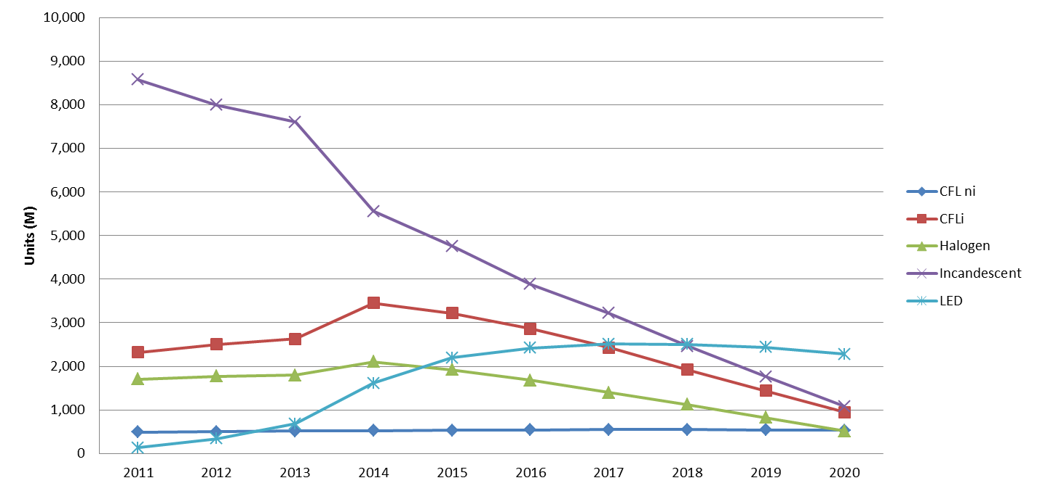
Lighting Unit Shipments
  Incandescent - In 2011 incandescent lamps made up 65% of shipments.
    By 2020, this number is expected to decrease to 20% in 2020.
  CFL - Due to price sensitivity in less developed regions CFL shipments will begin leading in 2015 with 43% of all shipments.
  LEDs – By 2019 LEDs will lead with shipments with 35%.

Slide 14
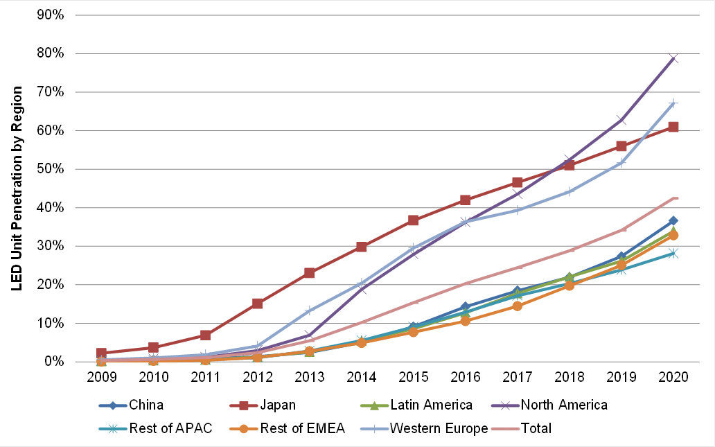
LED Penetration by Region

Slide 15
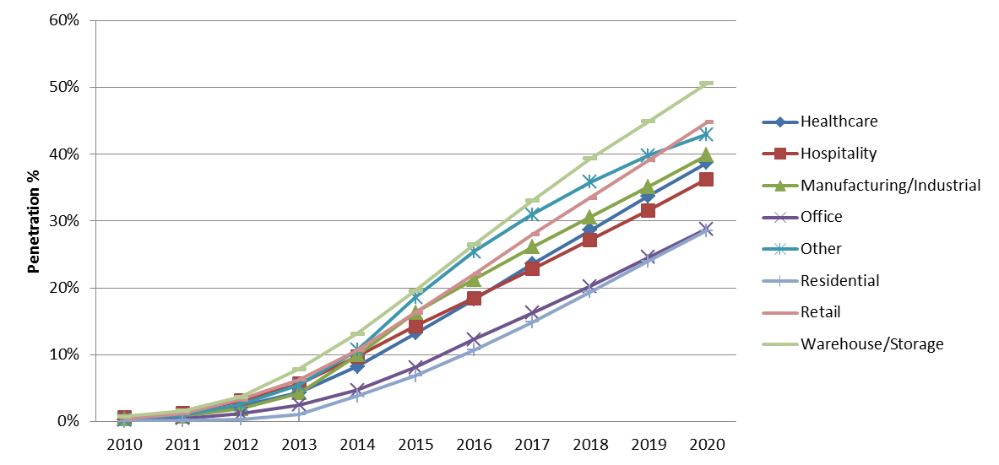
LED Penetration by Application
  Office and Residential have the lowest penetration in 2020 of any other applications.
      Residential
        Reactive vs. proactive replacement
      Office
        Relies predominantly on fluorescent technologies and a disconnect between office owners and office utility payers exist

Slide 16
Competing Interests
  Halogen, CFL and LED all competing for a piece of the pie
    Halogen - Looks and behaves almost identically (short life and all) to their beloved incandescent, but, is 3-5 times more expensive, depending on the market
    CFL - has a longer life than incandescent but contains toxic mercury, is accused of giving off “too white” light, has a shortened life when turned on and off too frequently and can also costs 3-5 times more than regular incandescent.
    LEDs - which can have a very similar light to incandescent, are marketed to have 25 times the lifetime of an incandescent, but also cost 20 times more. LEDs also benefit from the fact that they have been marketed as the next best thing since sliced bread by government, media and industry alike.
Notes:
Residential is expected to lead from 2013 and dominate at over 50% from 2015 due to being the largest overall market as number of sockets out there.
In this table, each luminaire has been counted as containing one light source or “lamp”. Even outdoor street luminaires have been counted as containing 1 “lamp”.

Slide 17
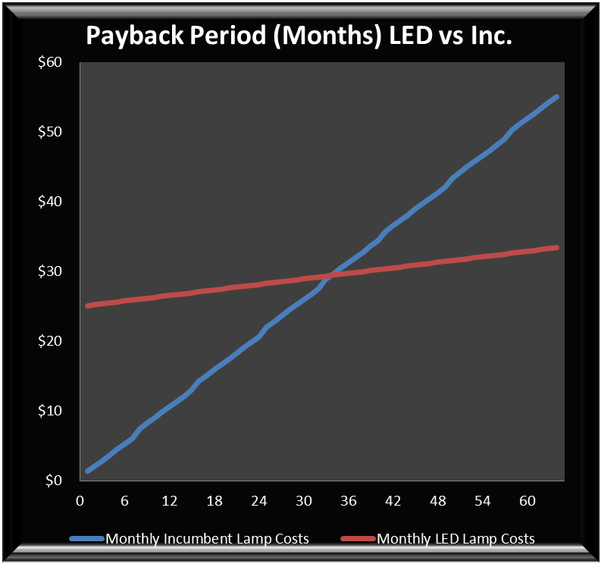
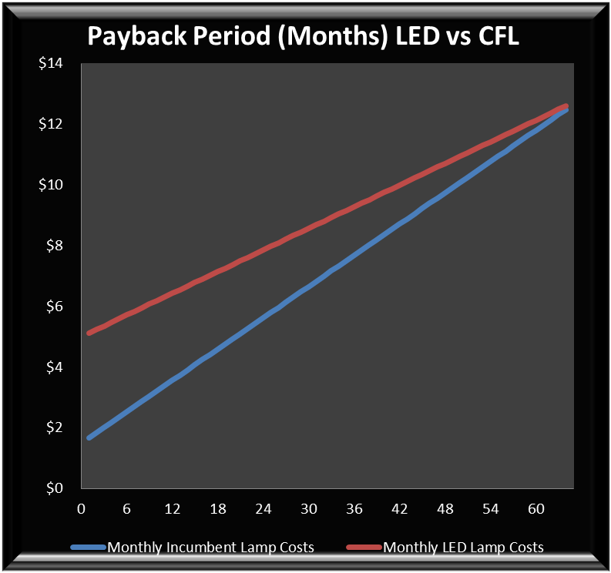
Energy Saving and Payback
Factoring in energy costs, a $25 LED pays for itself relative to a $0.55 60W incandescent lamp in approximately 34 months assuming 4 hours of use per day and energy costs of $0.11 kWh.
Payback vs. CFLs is nowhere near as good. Even at a cost of $5 for the LED lamp and $1.50 for the CFL (Greater than 65 months payback with same assumption).
Notes:
Residential is expected to lead from 2013 and dominate at over 50% from 2015 due to being the largest overall market as number of sockets out there.
In this table, each luminaire has been counted as containing one light source or “lamp”. Even outdoor street luminaires have been counted as containing 1 “lamp”.

Slide 18
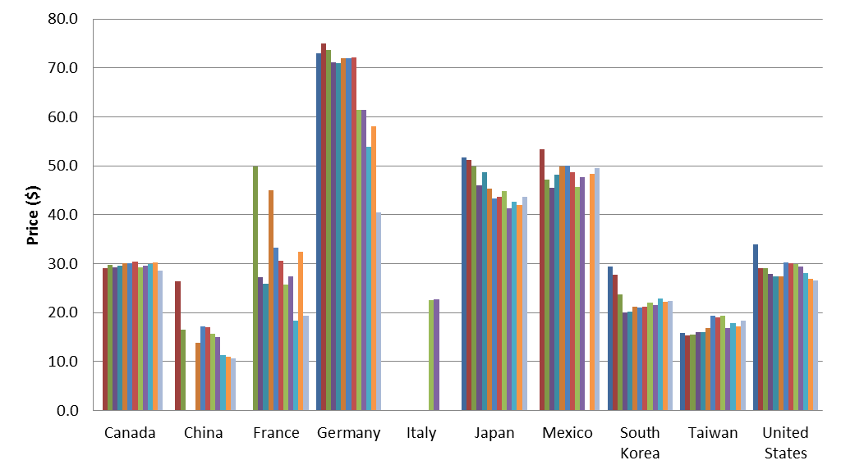
LED Lamp Tracker
Recently developed a global LED lamp tracker covering LED lamps for sale in Australia, Canada, Chile, China, France, Germany, Italy, Japan, Korea, Mexico, Peru, Taiwan, UK and the USA
Over 1,400 individual model numbers included in report covering over 70 brands.
Average 60W incandescent replacement lamp prices shown for September – September below. Wide range of prices depending on the country, with average price decreasing 9% globally and 20% in the US and 18% in the UK.
Notes:
Note: Gaps in data are due to certain products being unavailable in certain months.
Residential is expected to lead from 2013 and dominate at over 50% from 2015 due to being the largest overall market as number of sockets out there.
In this table, each luminaire has been counted as containing one light source or “lamp”. Even outdoor street luminaires have been counted as containing 1 “lamp”.

Slide 19
Efficiency Forecast for Lighting
Efficiency is expected to be more than doubled from 2010 to 2020 due to more advanced device structures.
After feedback from various suppliers, 2012 lumens/watt has been reduced from 136 to 122. This is the industry average, while 2020 has been reduced from 235 to 210.
Notes:
Residential is expected to lead from 2013 and dominate at over 50% from 2015 due to being the largest overall market as number of sockets out there.
In this table, each luminaire has been counted as containing one light source or “lamp”. Even outdoor street luminaires have been counted as containing 1 “lamp”.

Slide 20
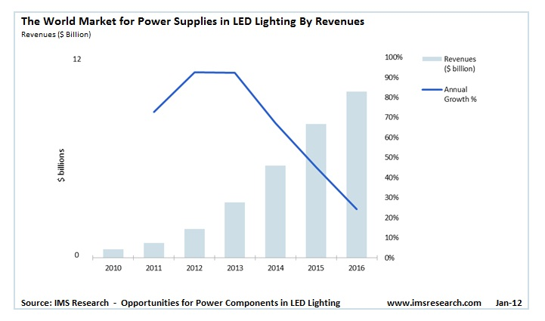
Power in LED Lighting
The world market for LED power supplies is projected to grow rapidly from $1.7 billion in 2012 to $10.0 billion in 2016
The largest opportunity is identified in retrofit LED lamps which are projected to drive more than $2 billion of power semiconductors in 2016.
Notes:
随着更换LED灯的势头快速发展，到2016年，潜在市场价值将超过40亿美元. 然而，目前LED灯的采用在很大程度上是依靠法律手段进行推动，但是，较传统照明技术，人们对LED灯的长期节能省钱的意识会越来越高，那时LED的市场将得到大幅度的提升。

Slide 21
LED market is suffering from overcapacity and lighting market has not yet taken off, so is fairly flat at present
Lamp market expected to reach its peak in 2015 at $41.3 billion, but then projected to fall to $24 billion in 2020.
~2013 - ~2017 will be the best years for LEDs in general lighting due to competitive prices and a market not near to saturation
The world market for LED power supplies is projected to grow fastest from 2012 to 2014
Summary
Notes:
Residential is expected to lead from 2013 and dominate at over 50% from 2015 due to being the largest overall market as number of sockets out there.
In this table, each luminaire has been counted as containing one light source or “lamp”. Even outdoor street luminaires have been counted as containing 1 “lamp”.

